Slide 1
Creating your Virtual Classroom in Google Slides

Slide 2
What you’ll need! 📁
A blank Google Slides
The Bitmoji Chrome Extension

Slide 3
Step 1: Open a blank Google Slide 🖱️
If you like the default dimensions then you can just go to step 2.
If you want to create a Google Classroom Header, change the page dimensions to 1,000 X 250 pixels by going to File > Page Setup.
Just a little warning: When uploading your header to Google Classroom, you’ll get the frustrating dark overlay on your image. It’s an accessibility things, and unfortunately cannot be changed. So with that in mind try to make everything with bright images.

Slide 4
Step 2: Collect your images 🖼️
The next step is to collect your images for your theme.
For inspirational posters you can go to ECHO-LIT. Then for the rest of your images you can do Google Images right on your Google Slides or search the web.
Note: When searching for images ensure that you look for a transparent background. For example: couch transparent background

Slide 5
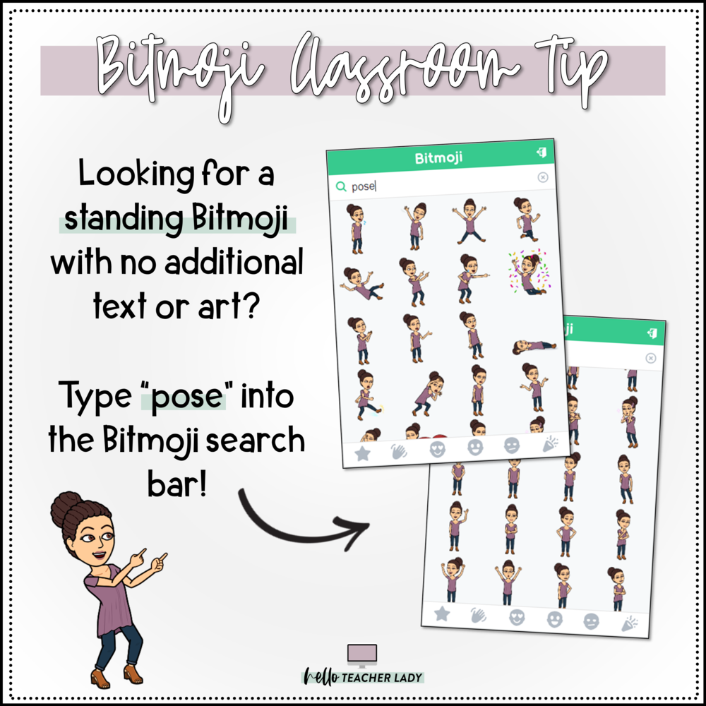
Bitmoji Tip

Slide 6
Google Image Search Tip 🔎
To help you search for your images, there are a few filter tools you need to know about. Filtering your search will allow you to find images you need a lot quicker (and it’s a useful tip to each student’s as well).
Go to Google Images and click Tools. This will bring up a variety of filter options.
On usage change to Labeled for Reuse and on color change to transparent.

Slide 7
Step 3: Create your Scene 🎨
Once you have your images and background, you can start creating your virtual scene.
Note: You can also search for wall and floor background in google slides when you search for images.
A couple of editing tips 📌
When resizing your images, make sure you are resizing from the corner point of the selected image. This will maintain the height and width proportions of the resized image. If you try to resize from one of the top or side points, the dimensions will not adjust proportionately.
To layer an image below another, right-click and select Order —> Send to back on Google Slides or right-click —> Send to Back on PowerPoint.

Slide 8
Step 4: Share Your Virtual Classroom ↗️
Once your digital classroom is created and you are satisfied with your work it is now time to share this with your students.
Download your completed digital classroom as a PDF. Making it a PDF will not allow students to make any changes to your virtual classroom.
Then go to your Google Classroom > click assignment > add file > upload your file

Slide 9
Have Fun Creating your
Digital Classroom

