Slide 1
Using Edpuzzle
To teach Remotely

Slide 2
Getting Started
First step…...access EdPuzzle and sign in with your Google account. This is
one of the features I absolutely LOVE. You will never have to worry about forgetting yet another username and password. 😊
When you create your account, please make sure you select TEACHER!
Next, you will be taken on a tour of this fabulous tool.
Also…..be sure to add EdPuzzle extension to your Chrome browser. It makes creating EdPuzzle lessons even easier!!!!

Slide 3
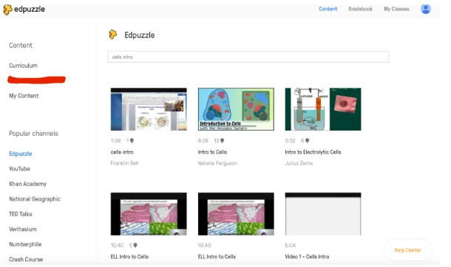
7 Reasons to use edpuzzle in the classroom
Use EdPuzzle as is or edit them further before you assign it to your class.
EdPuzzle has tons of already edited videos you can either add to or copy and use as is for your students. This is perfect when you need something that is of quality, but you just don’t have time to do it from scratch.

Slide 4
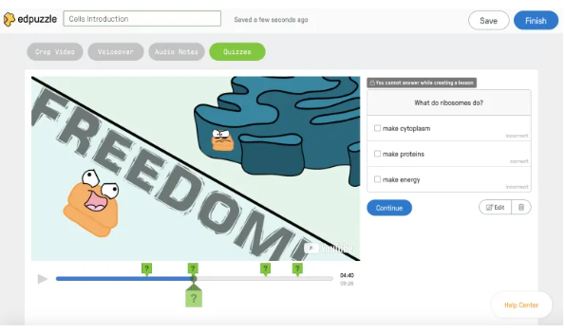
7 Reasons to use edpuzzle in the classroom
Add short answer and multiple choice checks for understanding questions to a video
You have found the perfect video on YouTube and want to show your students or you’ve uploaded one of your own video. You can now edit this video and add your own questions to the video! If you find a video where someone already added questions, you can use those same questions and/or delete some of the questions you don’t like.

Slide 5
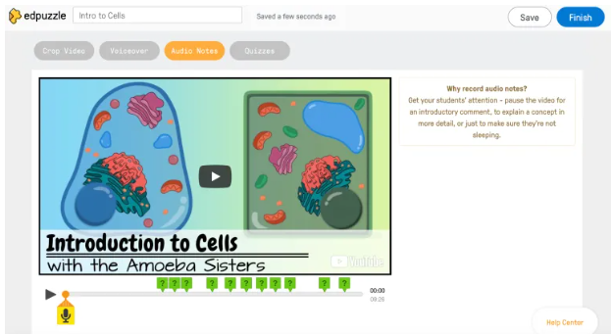
7 Reasons to use edpuzzle in the classroom
Add your own audio commentary to a video.
You can add audio comments to your video for your students. These audio comments can be simple explanations in your own words or things you want your students to think about and remember.

Slide 6
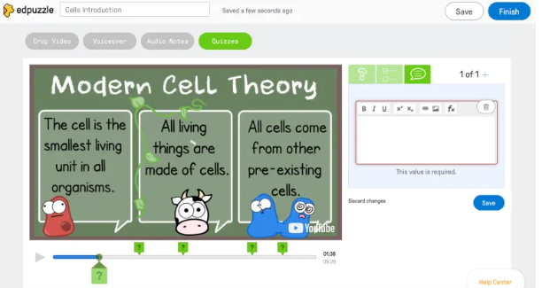
7 Reasons to use edpuzzle in the classroom
Add your own written comments to a video.
You can add comments that give reminders to take notes on a certain topic. It is a great way to see things in a written format and a way for you to ask questions that you want your students to think about as they watch a video.

Slide 7
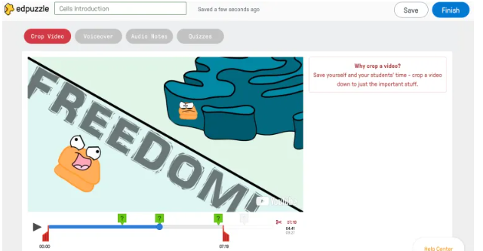
7 Reasons to use edpuzzle in the classroom
Crop the videos you choose to assign.
You like a video, but you really only like 1 minute of it. With EdPuzzle you can crop the video that you choose to the section that you like and that you feel is most relevant for your students.

Slide 8
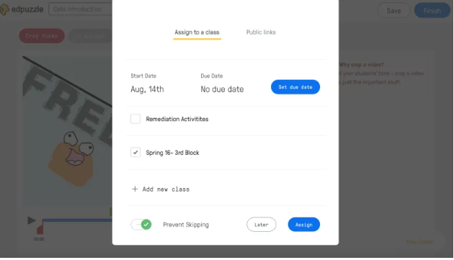
7 Reasons to use edpuzzle in the classroom
Students can view the video on the EdPuzzle site or you can send out the link.
You can now link your Google Classroom to EdPuzzle. You can share it to your Google Classroom right from the EdPuzzle site or you can copy the link to your Google Classroom. Once the students login to EdPuzzle to watch the video, you can see the results of each student and their progress.

Slide 9
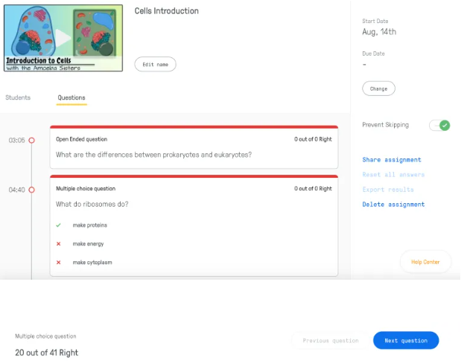
7 Reasons to use edpuzzle in the classroom
Track student progress and progress
This is a great way to see how students do. EdPuzzle allows you to see how far each student has gotten into the video or tell you they have finished the assignment.

Slide 10
EdPuzzle is Teacher friendly
Students can use the app
Students cannot skip ahead to the questions. If the student leaves the page, the video will automatically pause.
It has math symbols and functions that you can input for questions and answer choices.
You can give automated feedback responses if students choose a certain answer choice.
Closed captioning is an option on many videos. Some videos even allow you to use closed captions in a different language.

Slide 11
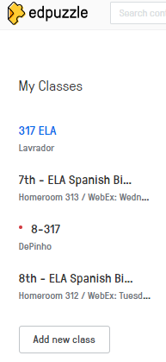
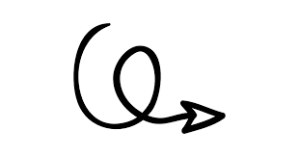
Set up your classes
You can set up as many classes as you want. If you have Google Classroom, you can just import your classes. You can also set up your classes based on subject if you teach all subjects. This makes it easier to find assignments for the teachers that teach all subjects.

Slide 12
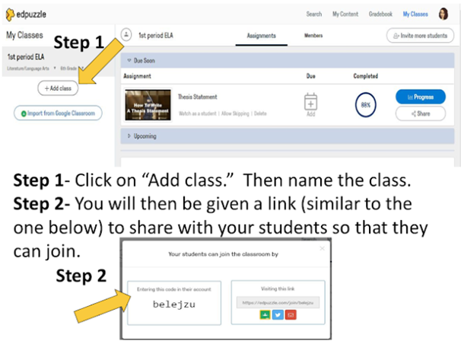
How to add classes, create video content, and then assign the videos

Slide 13
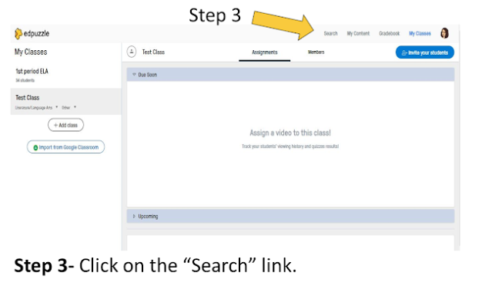
How to add classes, create video content, and then assign the videos

Slide 14
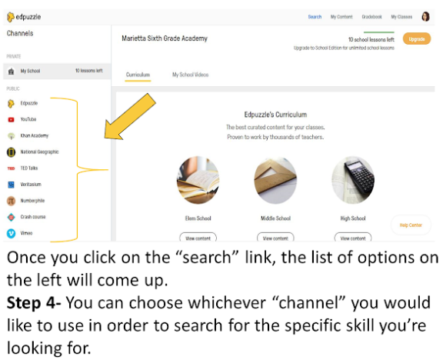
How to add classes, create video content, and then assign the videos

Slide 15
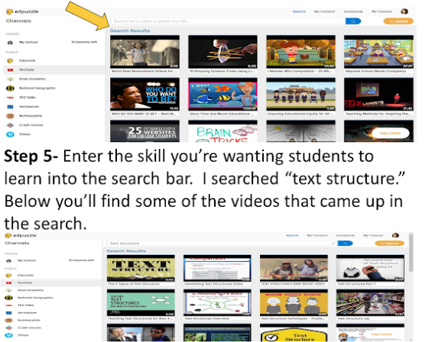
How to add classes, create video content, and then assign the videos

Slide 16
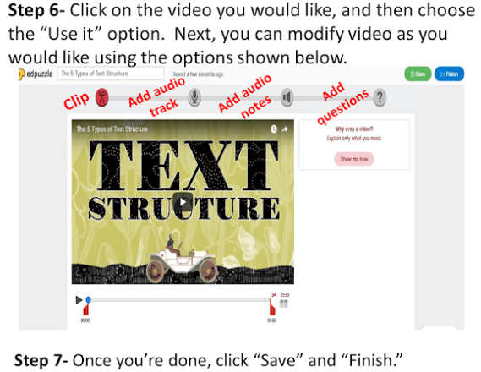
How to add classes, create video content, and then assign the videos

Slide 17
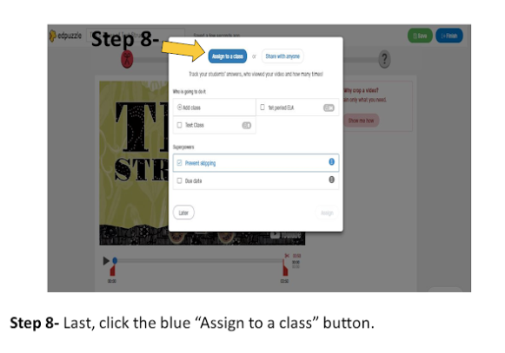
How to add classes, create video content, and then assign the videos

Slide 18
Adding questions to your Edpuzzle
There are three choices that you can add to your video. Multiple choice, open ended questions, or you can add a voice note.
The multiple choice question are automatically graded for you! Great right! And your students can practice their critical thinking skills on an open ended questions.
To add these features, stop the video where you choose, and click on the kind of questions you want. For multiple choice questions, make sure to enter in the right answer choice with the green checkmark, and the rest with the red plus.
Note: Pleasure ensure that you click finish when you are done editing the video.

Slide 19
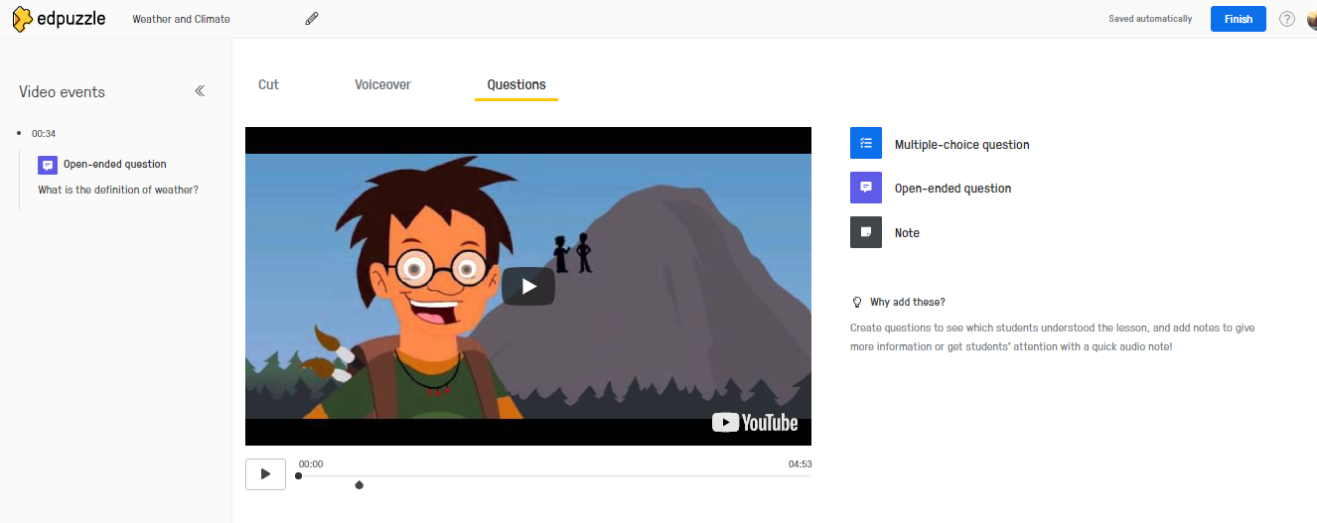

Slide 20
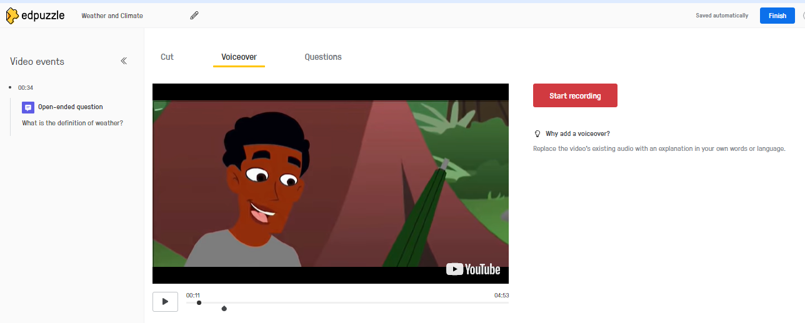
Adding Voiceover
This is a really cool feature if you would like to give your own commentary along the way. For example: “This next part is going to tell you the main idea, so I really want you to listen for it.”

Slide 21
🌟How to cut a video🌟
If you found the perfect video but only need to use part of it then just cut it.
To cut a video, follow these steps:
📌 In the video editor, click on the “Cut” tab.
📌 Below your video, you’ll see a blue bar. Drag the white vertical line at either side of the bar to crop from the beginning or the end of your video.
📌 If you want to add another cut to your video (for example, if you want to cut a section from the middle), click the “Add cut” button. You can repeat this step as many times as you like!
📌 When you’re finished, the sections you’ve cut will appear in gray and the remaining video will appear in blue in the bar.
📌 To preview how your video will appear with the cuts, drag the black ball back to beginning of your video.

Slide 22
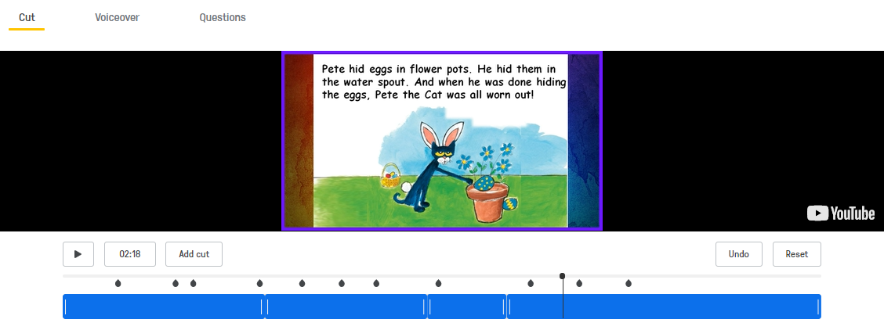
🌟How to cut a video🌟
This is what the video will look like with various cut throughout.
Note: You will need to play video in order to add more cuts.

Slide 23
🌟How to delete a question, note or Voiceover🌟
To delete a question or note, follow these steps:
📌 In the video editor, click on the question or note you want to delete from the “Video events” column on the left. This will display it to the right of the video.
📌 Click on the trash bin icon below the question or note, and you’re done!
To delete a voiceover, follow these steps:
📌 In the video editor, click on the “Voiceover” tab.
📌 Click on the trash bin icon next to the recording you want to delete, and you’re done!

Slide 24
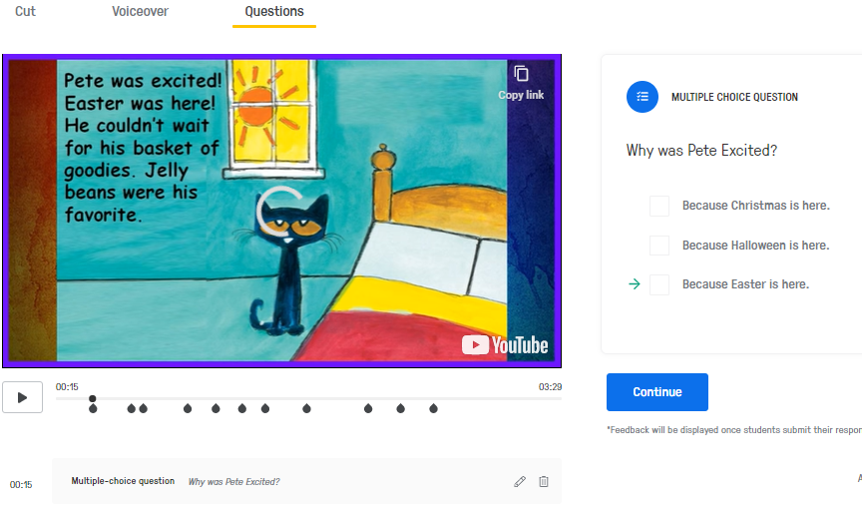
🌟How to delete a question, note or Voiceover🌟

Slide 25
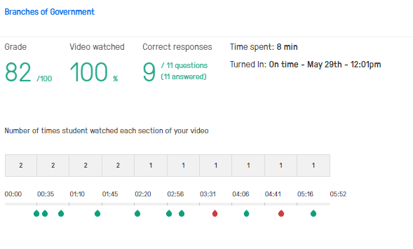
Look at student data

Slide 26
Screencastify & Edpuzzle Integration
You can now create instructional videos for your students using Screencastify and then use your EdPuzzle extension, to quickly embed formative assessment questions in the video and assign the video to your students through EdPuzzle.
The Screencastify & EdPuzzle integration allows you to skip posting to YouTube, especially since the district doesn’t really allow students to play YouTube videos.
Follow these steps to integration EdPuzzle in your Screencastify account.

Slide 27
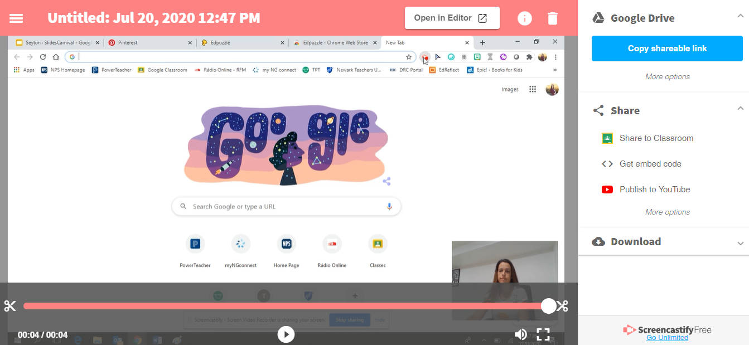
Open a Screencastify recording and click on “more options” on the right side.

Slide 28
Next, click on “add more options”

Slide 29
Then, slide the EdPuzzle tab over…...

Slide 30
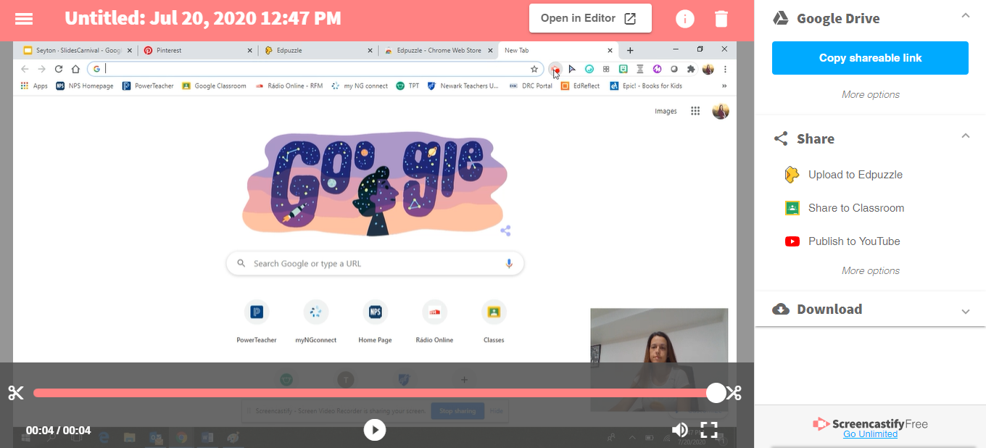
And EdPuzzle magically appears on your share options list!

Slide 31
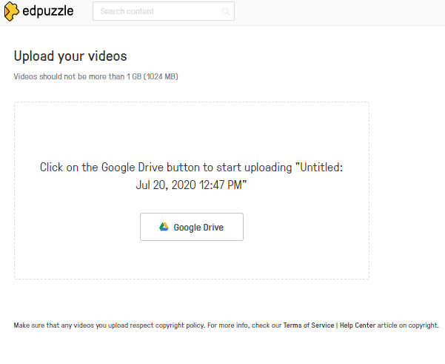
When you’re ready to upload your video to EdPuzzle, select the “upload to EdPuzzle” option. Next, you’ll be asked to log in on EdPUzzle. You should always log in with Google - and grant access to your Google Drive. Then, you’ll click on the Google Drive icon and that’s it! Your video is uploading to EdPuzzle!

