Slide 1
Getting Started
with

Slide 2
SETTING UP FLIPGRID
When getting started with Flipgrid, the first thing you have to do is set up your grid. Setting up your grid is Flipgrid terminology for setting up your class. You can create as many grids as needed. If you want to create a grid for each subject you teach, you can easily do that. Also, if you are departmentalized, you can create grids for each of your classes.

Slide 3
SETTING UP FLIPGRID
If you are new to Flipgrid you will first need to set up your account.
Go to Flipgrid
Login with Google, making it easier to never forget your login information
Follow the prompts to set up your account

Slide 4
SHARING FLIPGRID WITH STUDENTS
You just spent time setting up your grid and customizing it so that it will catch students’ attention. The second step when you’re getting started with Fipgrid is sharing the grid with your students. Students need to be able to access the grid so that they can view your assignments and submit their responses.

Slide 5
SHARING FLIPGRID WITH STUDENTS
In order for students to access your Grid they will need to do the following:
🙂 Send students the link to flipgrid
🙂 Students will then click on Enter a Flip Code
🙂 Students will then enter you code for your classroom
🙂 Once they enter code, students will be part of your classroom

Slide 6
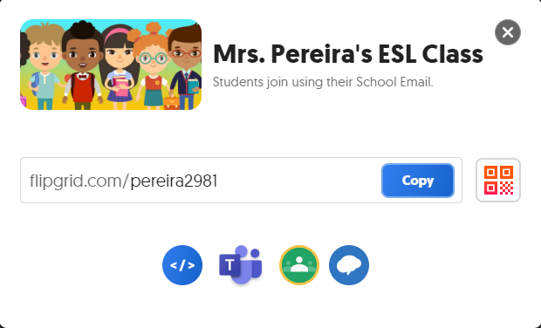
SHARING FLIPGRID WITH STUDENTS
Sharing your grid with students only takes a few seconds. There are various ways to share.
You can copy the link, share on teams, share on Google Classroom, or share on remind.

Slide 7
CREATING A FLIPGRID TOPIC
This is where things start to get fun! After you’ve created a grid and shared it with your class, the next step is creating your first topic. You may have noticed that Flipgrid has its own terminology. “Create a topic” means the same thing as “create an assignment.” Keep in mind that students will respond to the assignment by creating a video. So, be sure to create a topic that will allow students to respond in a fun way using that form of media.
It may seem like there are a lot of steps involved when it comes to creating your topic. But, it gets much easier and faster with practice. After you’ve created one topic, creating more topics will be simple.

Slide 8
CREATING A FLIPGRID TOPIC
Here are the steps for creating a topic:
Click on Add new topic
Name your topic
Choose your prompt (here you can add a question or text)
Choose a recording time (Flipgrid has a default time of 1 min 30 sec)
Optional: Add any type of media to your topic

Slide 9
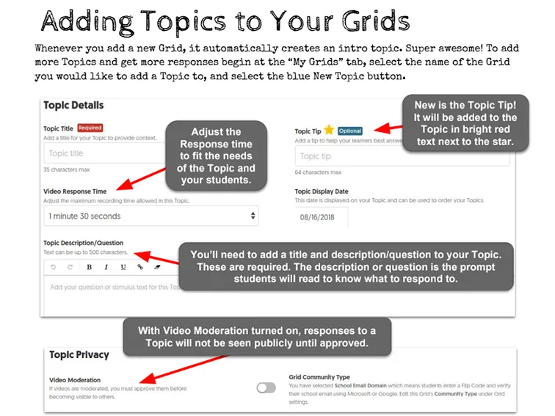

Slide 10
CREATING STUDENT RESPONSES IN FLIPGRID
The final step when getting started with Flipgrid is for students to upload their responses. One of the reasons why students love Flipgrid is because they can upload video responses similar to the way they upload videos to social media sites. They will record a short video of themselves answering the prompt or completing the assignment you posted. Then, they can add stickers, text, and other fun elements to their video responses. It is important to encourage students to be creative, but always remind them that it is most important that they show their understanding of the assignment in a meaningful way.

Slide 11
CREATING STUDENT RESPONSES IN FLIPGRID
Here are the steps for students to be able to response in Flipgrid:
🍎Students will click on the link you shared with them
🍎Students will login with google
🍎Students will watch the video or text you sent them
🍎Student will then click on the sign
🍎Students will be able to be as creative as they want in their video response

Slide 12
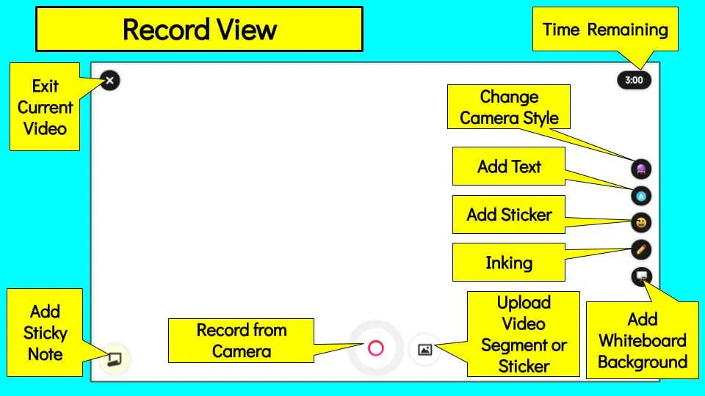
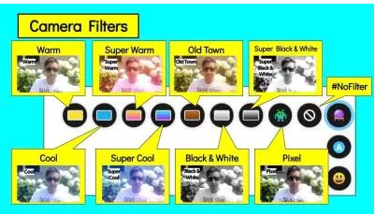
An introduction to the NEW Flipgrid Shorts Camera
When you first enter the camera, you will see this view. One important note: if you exit the video using the x in the upper left corner, you will lose all your work.

Slide 13
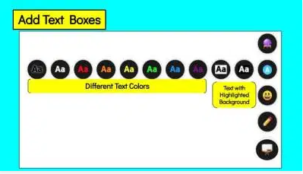
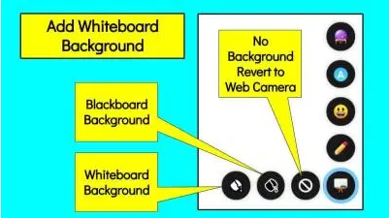
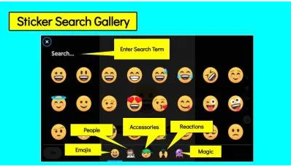
An introduction to the NEW Flipgrid Shorts Camera

Slide 14
Live Recording
While recording live many of the customization functions still work. The camera filter can be changed and text boxes can be added and moved. In addition, typing can be done live while recording. Stickers can be added and images can be uploaded. Stickers and images can be moved and drawing can be done live and moved while recording.
During recording, the record button can be used to pause for a moment and then start recording again. This is a great feature when students need a break when presenting large amounts of information or the canvas needs to be changed without adding dead air to the video segment.

Slide 15
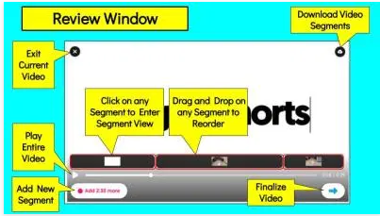
Trimming & Arranging Video
New segments can be added using the “Add [Time Remaining] more” button. This will take you back to the Add Segment View. The current segments can be dragged to reorder the sequence. If satisfied after viewing the entire sequence, hit the right button to finalize the video. If fine-tuning needs to be done to any segment, just click on it. That will take you to Drag and Trim View.

Slide 16
HOW TO RECORD A VIDEO
HOW TO RECORD A VIDEO
Click on the link in Google Classroom or with the Grid code.
Log into the Grid using your email
Carefully read the question prompt.
Click the to start your video.
Click the record sign to start your recording.
Click the arrow to playback.
Watch your video back. Click the X if you want to re-record. Otherwise, click the arrow again.
Take a selfie as your cover.
Publish to our class grid!
Click on the link in Google Classroom or with the Grid code.
Log into the Grid using your email
Carefully read the question prompt.
Click the to start your video.
Click the record sign to start your recording.
Click the arrow to playback.
Watch your video back. Click the X if you want to re-record. Otherwise, click the arrow again.
Take a selfie as your cover.
Publish to our class grid!

Slide 18
Tip #1: Start simple. If your students are a bit hesitant to put themselves on camera, their nerves will be even stronger if they're asked to answer a challenging question right away. Start with something fun and simple that will get them comfortable.
Tip #2: Post the first video yourself. If students see you relaxed, authentic, or even silly, students will feel more comfortable doing the same. Simply record a video as the Topic Focus!
Tip #3: Record with a buddy, group or with family members. Motivation and confidence increases with the support of peers and family.

Slide 19
Tip #4: Use Pixel Mode, Stickers, or Filters. Students have access to fun Styles in Flipgrid, such as Pixel Mode! Students can use this feature to pixelate the video, hiding their face, or use it to reveal clues throughout the video. In addition, students can add an emoji as a sticker over the video to hide their face.
Tip #5: Use Whiteboard mode or record something else! The Flipgrid camera is filled with powerful features, such as Whiteboard Mode, emoji, inking, and text, that allow your students to share their voice without their face being on camera.
Tip #6: Moderate Topics. The moderation feature allows you to choose which responses show on the Grid.

Slide 20
Tip #7: Use Sticky Notes. Digital Sticky Notes in Flipgrid allow students to jot down key points and notes they want to remember, increasing confidence as they share their ideas.
Tip #8: Interview a friend - This is a great way for students to help each other become comfortable recording while also practicing speaking and listening skills. Pair quieter students with a student who is more comfortable on camera. As they ask questions they can pause the video to gather their thoughts before speaking.
Tip #9: Create paper slides videos - Paper slides allows students to unleash their creativity by creating a slide for each of their big ideas. As the student is speaking, someone else can move the paper slides into the view of the camera, or they can upload each slide as an image and record a voice over!

Slide 22
Flipgrid can serve more than academic purposes. Iit can also be an excellent tool for building classroom community. There are several different ways to do this. You could have students wish each other a happy birthday or send home get well messages when a child is out sick. One fun strategy is to choose a student of the week or month. Over the course of the month, the student of the month’s classmates should record a video to share a compliment or other positive affirmation about the student of the month. Of course, if you do this, students will need to be taught how to leave appropriate responses, because students can be a bit, okay sometimes a lot, over the top. The responses should be meaningful.

Slide 23
Thank you Diana for sharing this tip:
When assigning a flipgrid to your students always add a note to all of the assignments telling the students that “This assignment is moderated so you will not see your video until I approve it. Please only record one entry.”
Dong this will prevent you from getting recordings multiple times and students emailing you asking where their videos are.

Slide 24
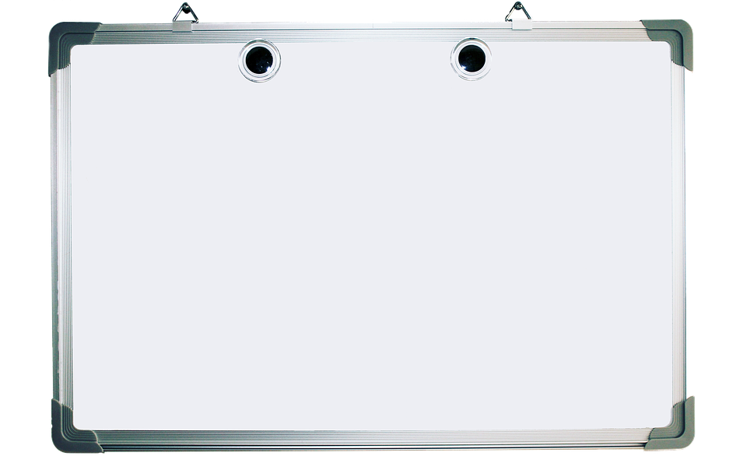
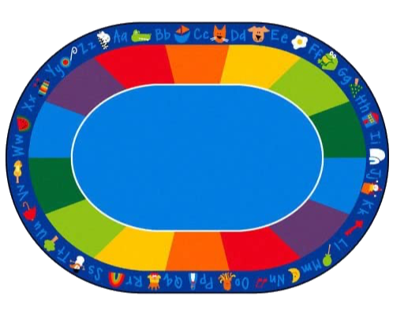
Thank You

