Slide 1
Getting Started
with
Google Forms

Slide 2
What are Google Forms?
Google Forms were created so that the user (you) can quickly ask questions and collect information from others. It’s really that simple.

Slide 3
Benefits of Google Forms
(in the classroom)
Google Forms can be a powerful tool in any classroom. Here are just a few of the main benefits:
📖 Save Time: This is one of my favorite features. The primary way that Google Forms saves us time is because it automatically grades quizzes and classroom activities for us. This is HUGE in our world.
📖 Collect Data: Yes! Google Forms can collect data. As your students complete activities, you can export all results to a spreadsheet, and viola…..instant data.
📖 Keeps you Organized: Fewers papers means less to keep organized. You can use google forms to help manage your classroom. Send home a survey for parents or use them for a class poll….by reducing the number of papers you are using, you avoid that massive pile of papers that we often have sitting on our desks.

Slide 4
How to Get Started with Google Forms #thebasics
👉To start a new document, Open up Google
👉 Click on your Google Apps
👉 Click on Google Forms, click on blank or choose from one of the templates available to you.

Slide 5
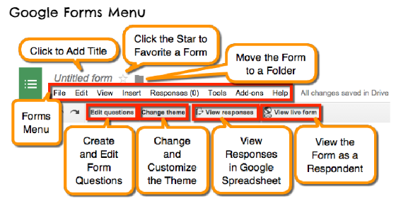

Slide 6
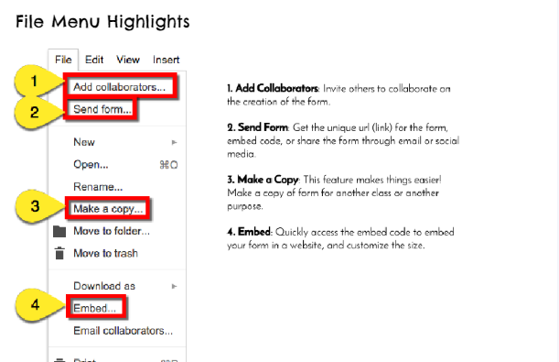

Slide 7
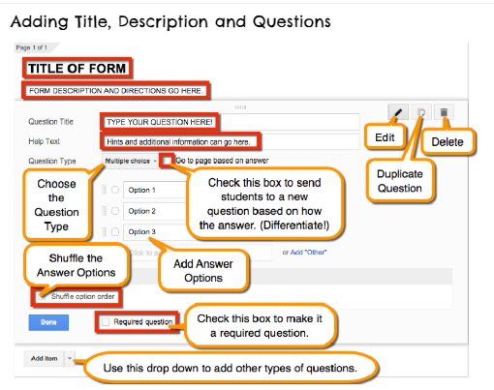

Slide 8
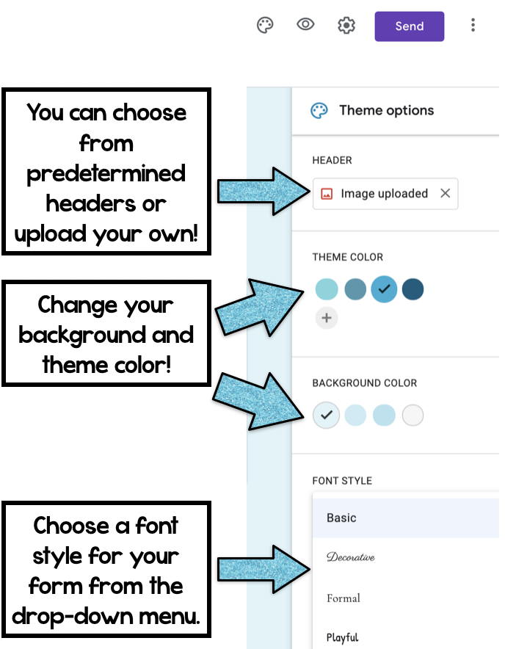
Google Form Features
NOTE: THE MOST IMPORTANT THING TO REMEMBER IS TO HAVE THE FIRST QUESTION ALWAYS ASK FOR STUDENT’S FIRST AND LAST NAMES AND MAKE THIS QUESTION REQUIRED. IF YOU DO NOT, YOU WILL HAVE NO WAY OF KNOWING WHO DID WHICH FORM.
When you’re creating your Google Form, Google lets you personalize it in many ways. You can change the header to a certain color, a pre-uploaded image, or one of your own images. You can change the theme color, background color, or both. You can even change the font style for your text in the form. This is definitely an extra (and not necessary) but designing the form makes it a bit more engaging and visually appealing to students.

Slide 9
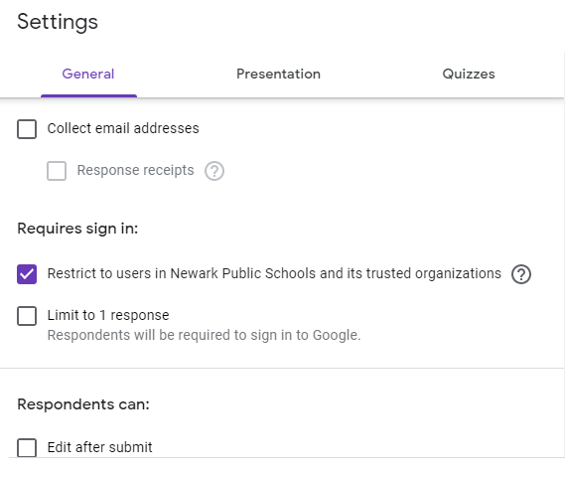
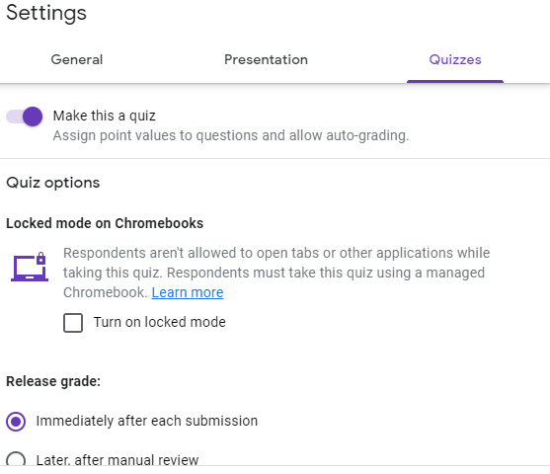
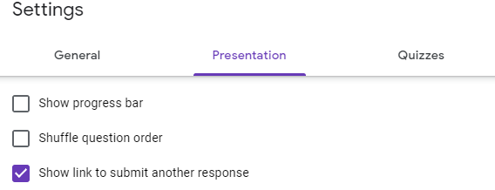
Setting up your Settings in
Google Forms
Whenever you create a Google Form ensure that you are adjusting your settings. In your settings you will be given options of who you want to access the form, how you want to present it, and whether or not you want to grade it.

Slide 10
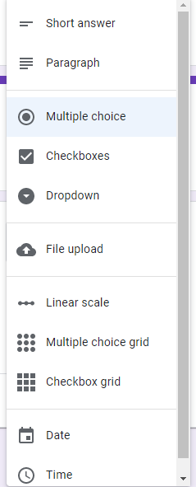
Types of Questions in
Google Forms
One of my favorite features of Google Forms are the different question types you can create.
There are the types of questions you can create:
✏️ multiple choice questions
✏️ short answer questions
✏️ paragraph answer questions
✏️ checkboxes for problems with multiple correct answers
You can mix and match any of these question types in the same assignment too. Multiple choice and checkboxes are the easiest for self-grading with numerical answers. Paragraph answers and other short answer questions will need to be manually graded.

Slide 11
Self-Grading Feature
Depending on the type of questions you include (multiple choice, checkboxes, and some short answer questions), Google Form assignments can be graded automatically!
Automatic grading by itself is amazing but there is an added benefit in that students can see their results instantly. No more asking you how they did on a quiz. With the self-grading feature, students can get instant feedback on how they did on an assignment. This feature is great for quizzes but can also help students reflect on their learning while they are practicing a skill independently.

Slide 12
Adding Images & Videos
In order to add an image you will first need to create a question. Once you create a question you will then click the image symbol. You also have options to add images to the answer key.
In order to add a video you will first need to create a question. Once you create a question you will then click the video symbol. When clicking the video symbol you will be taken to youtube where you will be able to attach any given video to your question.

Slide 13
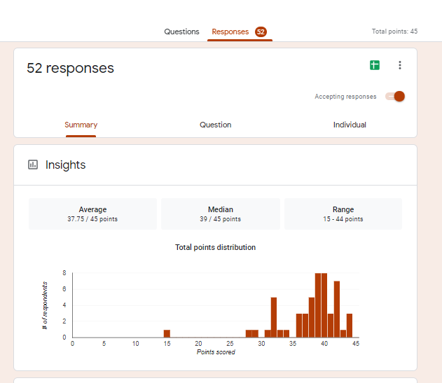
How to Collect Data
This is one of Google Forms best features! Forms makes it so easy to collect data on students. You can then use that data to help determine which students need reteaching or how to group students for future instruction.
You will also have the option to export your data into Google Sheets.

Slide 14
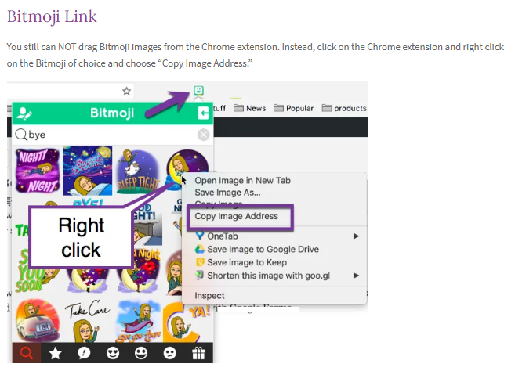

Slide 15
