Slide 1
Get started with
google classroom

Slide 2
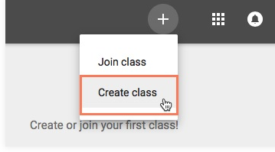
Setting up your google classroom
To create a brand new google classroom go to classroom.google.com and sign in using your Google Account. Select “create class”.

Slide 3
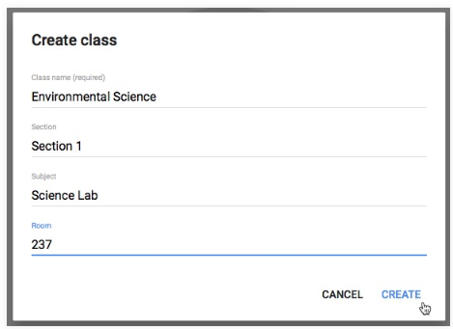
Setting up your google classroom
Set up the following things:
🍎 Class Name
🍎Class Code - this is how students will join your class. You can send it, display it, disable it, and reset it.
🍎 Comment settings - decide if you will allow students to comments or not.
🍎 Grading settings

Slide 4
Adding students to your Class
Students need to go to classroom.google.com on a google chrome browser to sign in. You would add your students by giving them the class code to enter to join!
The 4 tabs at the top of your class are:
✏️Stream: Recent activity
✏️Classroom: where to add work for your students
✏️People: who is in your class
✏️Grades: see class grades

Slide 5
Making an announcement
This is a great option when you just want to tell students something. For example, if I want to remind students that there will be no school tomorrow, then I would just post it in the announcement section.

Slide 6
Assigning classwork and Activities
One of the best features about Google Classroom is that you can add assignments and activities directly from your Google Drive. You can also add assignments from your documents. For example, if you want to assign a graphic organizer, you can just find it on your drive and attach it to the assignment.
Important Note: Always make a “master” copy of your resources. When you want to assign something to your students, make a copy, delete any slides you don’t want them to do at that time, and rename it.

Slide 7
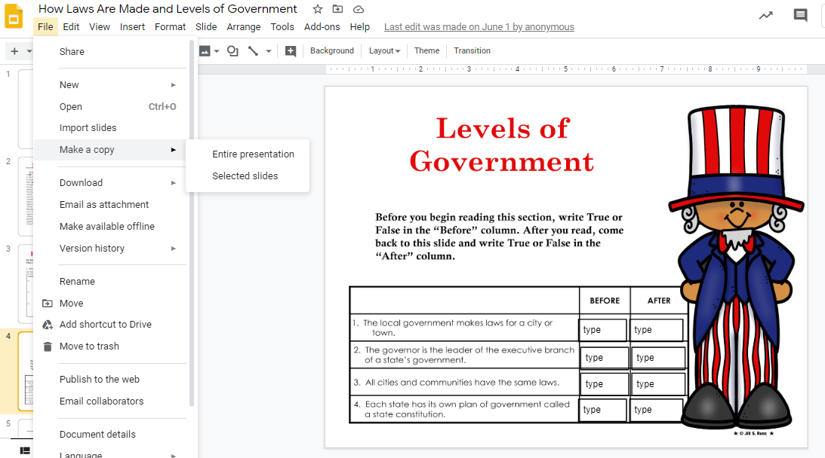
Assigning classwork and Activities

Slide 8
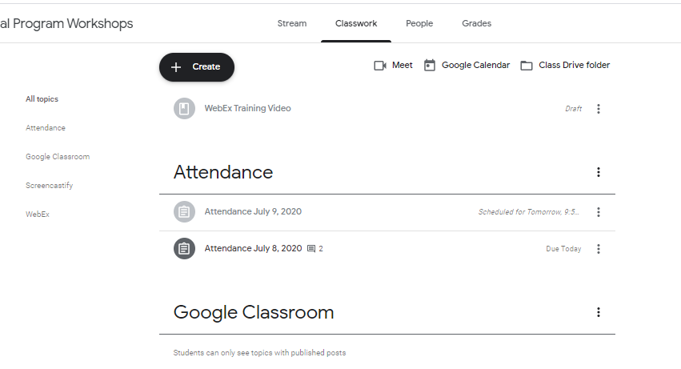
Assigning classwork and Activities
Whenever you want to create new assignments, questions, or materials you will need to navigate over to the classwork tab.

Slide 9
Important tips when assigning classwork
📚 You can have multiple classes and decide which class or classes get which assignments
📚 You can assign things to everyone or to certain students (this is GREAT for differentiation)
📚 Assign a point value to an assignment if you are grading it
📚 Assign a due date (optional)
📚 Write instructions on what the students have to do in each assignment (optional)
📚 You can schedule, save drafts, or post assignments

Slide 10
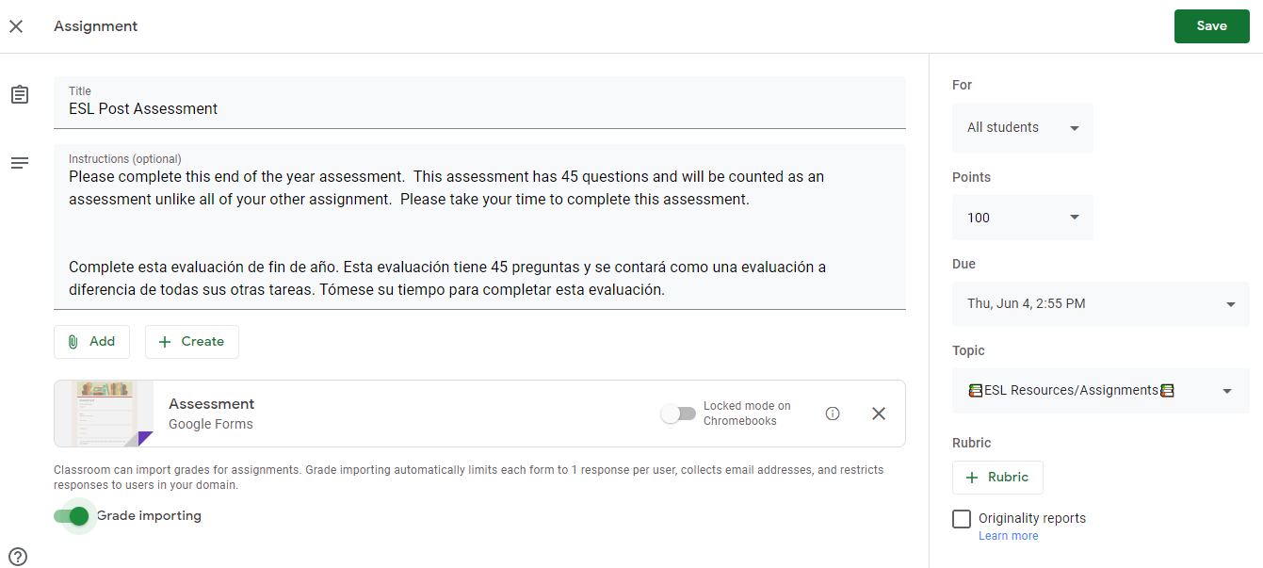
Important tips when assigning classwork

Slide 11
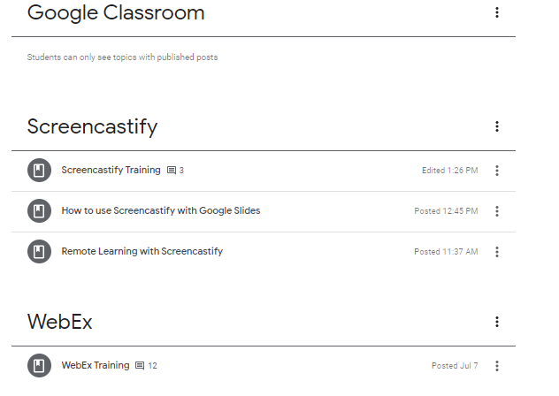
Create topics
Organizing my classroom by subjects is amazing. Love that you can just search for assignments by topics. Doing this makes the assignments easier to find!

Slide 12
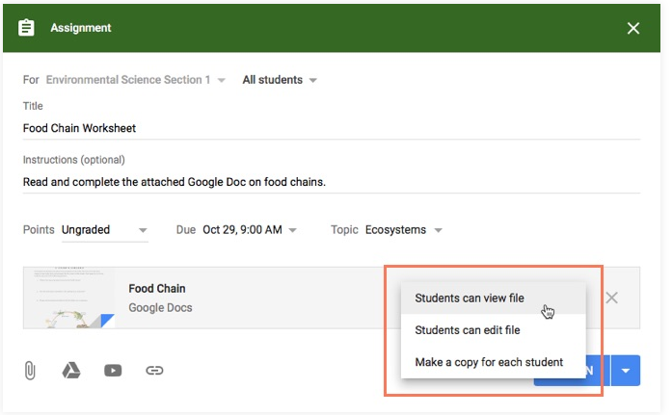
View, collaborate, Edit
Depending on the assignment you are attaching the drop down on the bottom right is very important.
🍎Student can view file: If you are wanting students to view them only.
🍎Student can edit file: If you want them ALL to edit and type on the same collaborative file.
🍎Make a copy for each student: This makes each students their OWN editable copy of a document so that they can type and interact with it before turning it in.

Slide 13
Class discussions
There are lots of ways to have class discussions through Google Classroom! You can post a question in the classwork tab and have students comments on that thread. You can also assign interactive slides and allow everyone to collaborate through there. If doing this make sure that you select “allow student to edit” when you assign a collaborative file!

Slide 14
Quizzes, TEsts, & exit tickets
Google forms can easily be used for quizzes, tests, check ins, and more! In Google Forms, select from a template that works best for you. There are options like blank quiz, exit tickets, assessment, and more. When creating quizzes, your quizzes can have multiple choice answers, short answer, long answer, and more. Just make sure to create the answer key so the form know which answers are correct.

Slide 15
Things you can attach to google classroom
(Using the assignment tool)
✏️ PDF
✏️Videos
✏️Links - website, Kahoots, youtube videos
✏️Any Google file (doc, forms, slides, sheets, etc.)
✏️Other websites like Newsela, Edulastic

Slide 16
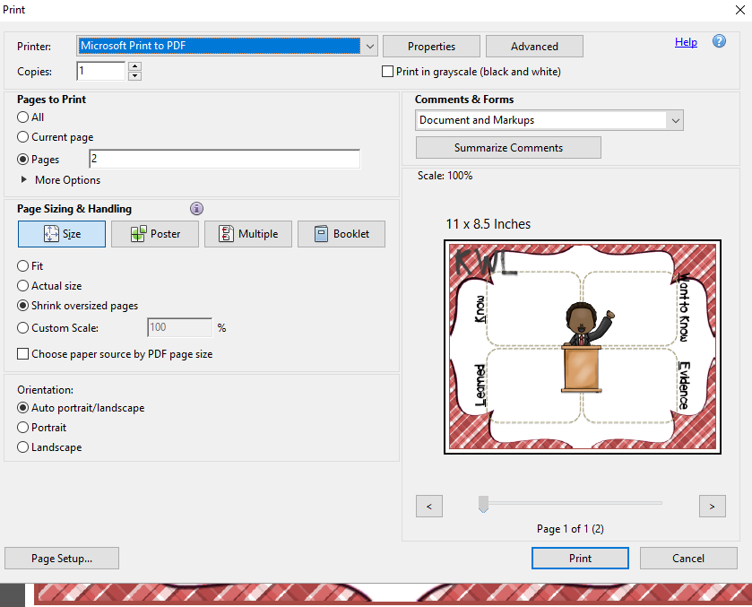
Attaching pages from a pdf documents
If you want to attach a PDF document, but only want to send your students ONE page there is a few ways to do this.
If you have a PC: open your PDF, go to file, print (type in your page numbers you want to save, and select “save as PDF” in the top drop down. Rename your file and then choose where you want to save the new file!
For MAC users: open your PDF with “Preview” go to File, Print (type in your page numbers you want to save, and select “save as pdf” in the bottom left corner. Then choose where you want to save the new file!

Slide 17
How to take a screenshot or snippet of a page or part of a page
Here is what you would need to do to take a screenshot or snippet of a page.
🍎 PC: Windows + Shift + S
🍎 MAC: command + shift + 4
🍎 Chromebook: Ctrl + Shift + Switch

Slide 18
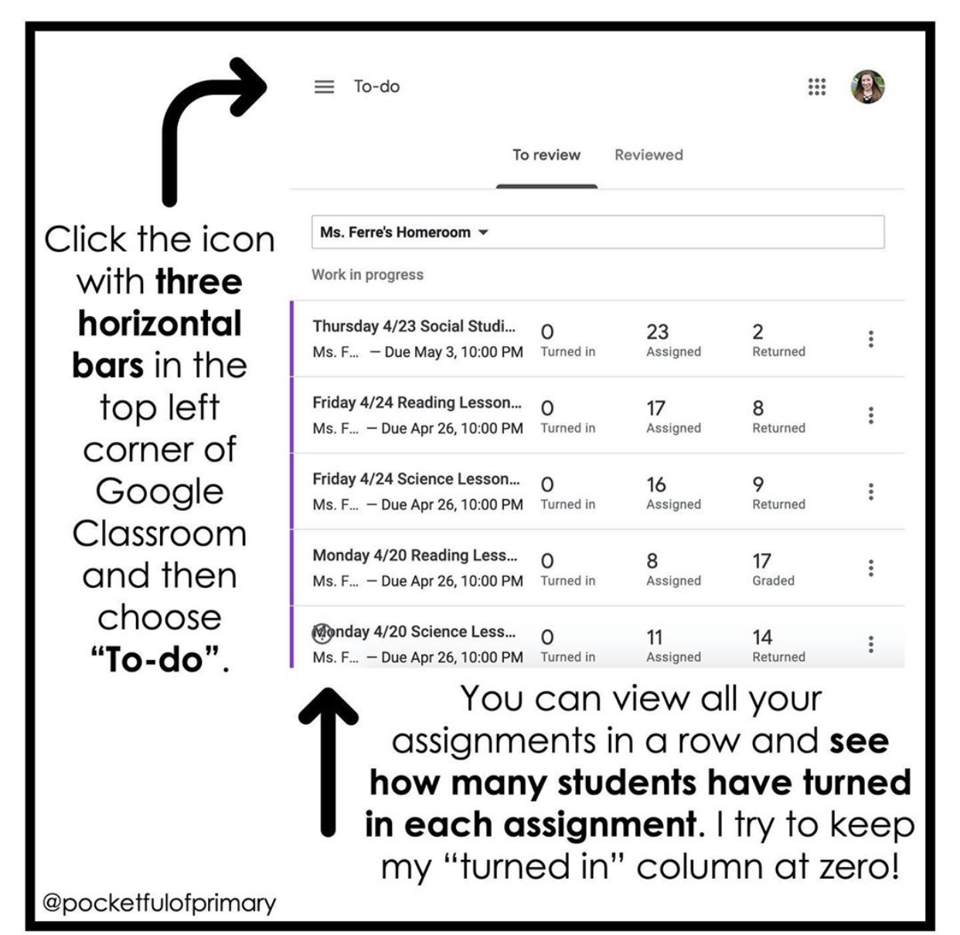
How to Cut your Grading time in Google Classroom
Going through your Classwork tab and clicking on each assignment to see if any students have turned it in takes FOREVER when you have a lot of assignments!
Click on the icon with the 3 horizontal bars in the top left corner of Google Classroom and then choose “To-do” (unfortunately this is not available on the phone app).
You will be able to view all of your assignments in a row and see how any students have turned in each assignment! You can even click on the assignment to open it in a new tab.

