Slide 1
Getting started
With
Google Docs

Slide 2
Overview of Google Docs
✏️ Word processing
✏️ Access anywhere, anytime from any internet browser
✏️ Collaborate and share viewing/editing privileges
✏️ Autosave and revision history
✏️ Share documents or folder with individuals or groups
✏️ Use ready - made templates

Slide 3
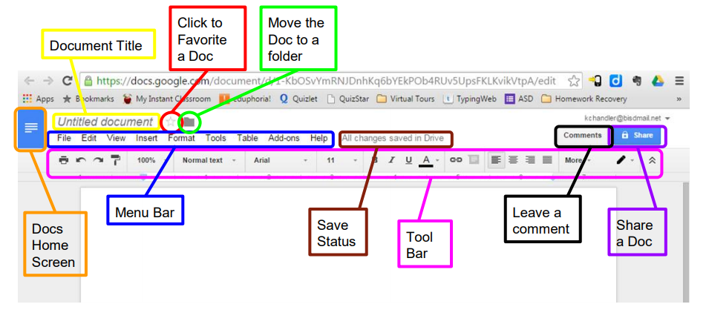
Google Docs User Interface

Slide 4
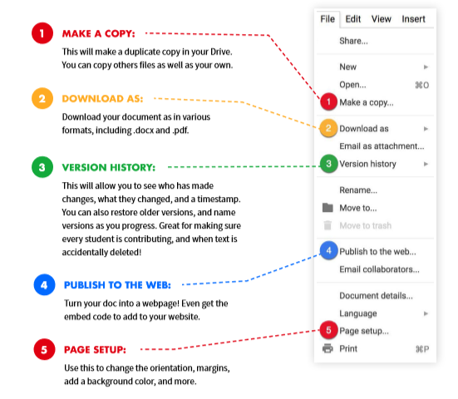
File Menu Highlights

Slide 5
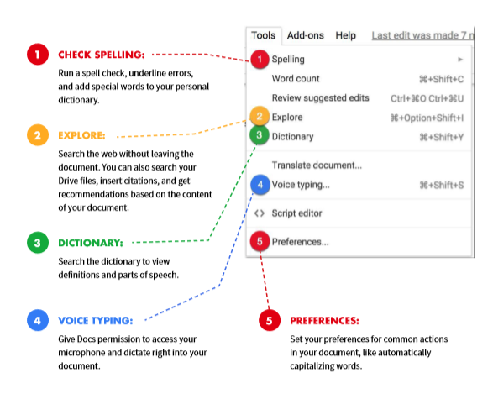
Tools Menu Highlights

Slide 6
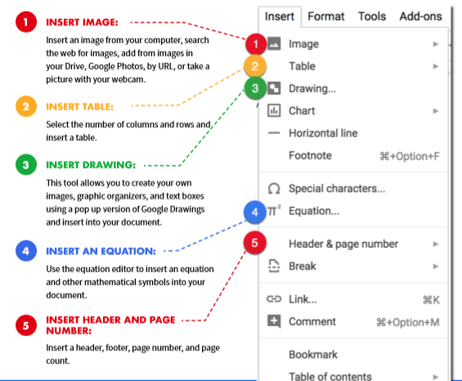
Insert Menu Options

Slide 7
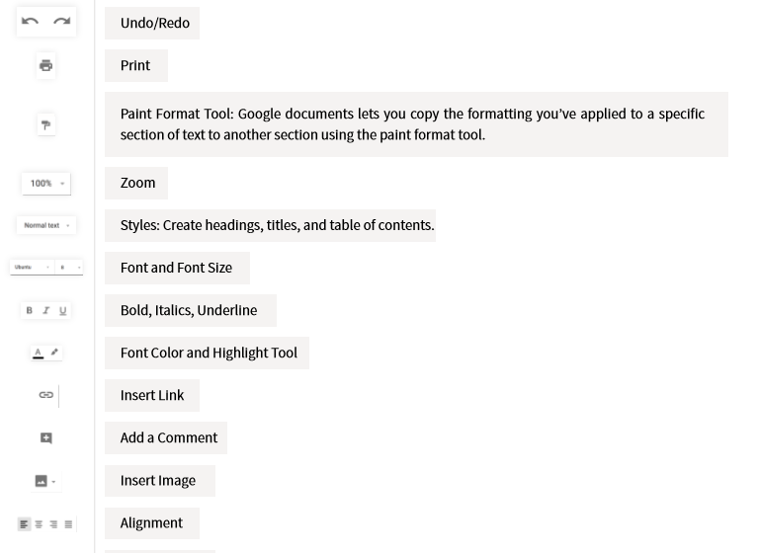
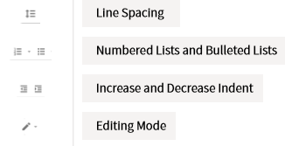
Main Dock Toolbar

Slide 8
Creating & Uploading Documents
🗒️ Open up Google
🗒️ Click on your Google Apps
🗒️ To start a new document, go to your drive, click on create and choose what type of document you want to create.
🗒️ Or you can click on the upload box (next to create) and upload a file or folder.
🗒️ It’s easy to find documents using the search bar - start by typing and it will make recommendations
🗒️ You can also click on sort to filter your docs by last modified, last edited, last opened

Slide 10
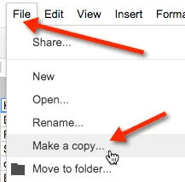
How to Make a Copy of Google Files
Step 1: Open the file (Google Doc) in your browser (Chrome is recommended)
Step 2: Go to the File menu and select Make a Copy
Step 3: A small pop up will prompt you to name your new copy and give you the option to organize it in one of your Google Drive folders. Click on the folder to select a different folder or create a new one.

Slide 11
Sharing Documents
🍎 There are two types of settings when sharing: visability (how people access your document) and sharing (who can edit or view)
🍎There are 5 visibility options: private, public on the web, people at my organization, people at my organization with a link, and anyone with the link
🍎There are three forms of sharing options: owners, editors, viewers

Slide 12
Collaboration
🍎 Real time collaboration - you can see who is doing what
🍎There is a built-in chat feature - you can access this feature by clicking on viewer and begin messaging
🍎You can also insert comments on a document. You would do this by highlighting the text you want to comment on then click insert and then comment. With this feature you can also reply to and resolve comments.

Slide 13
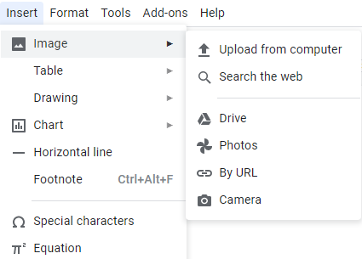
How to Insert images
🍏 Inside of your document go to the Insert menu
🍏 Select Image
🍏 Select where you would like to get your image from
🍏 Copy and paste the image onto your document
🍏 You can resize your images by selecting and dragging the blue “handles” until you have the desired size. To keep the image from looking out of proportion, hold the SHIFT key as you click and drag.

Slide 14
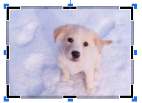
How to crop images
✂️ Double-click the image you wish to edit or click on the crop button in the toolbar. (Note: Clicking the image one time will give you the blue handlebars for resizing and moving. A double-click will give you the new cropping tools).
✂️ Click and drag the black cropping bars on the corners and sides to crop your image.
✂️ Select the area you wish to crop, then click “Enter” on the keyboard or click the crop button on the toolbar to crop the image.

Slide 15
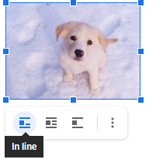
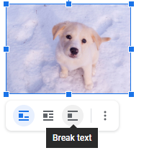
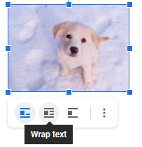
Decide how to insert Images around text

Slide 16
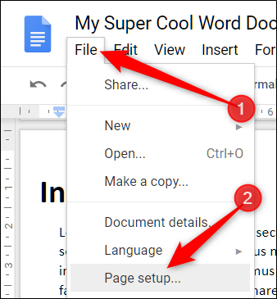
How to Set up your page
In Google Docs
Step 1: Go to File
Step 2: Click on Page Setup and change the settings to your liking

Slide 17
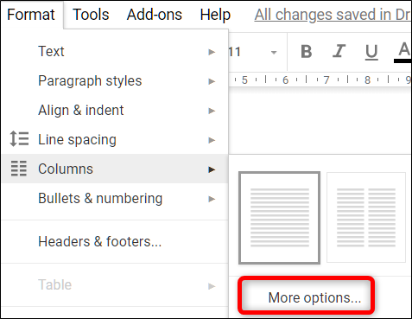
How to Create Columns
In Google Docs
In your Google docs, click on Format > Columns
If you don’t have any text in your file, you won’t see much happen. However, notice the ruler at the top of the document now shows column breaks.

Slide 18
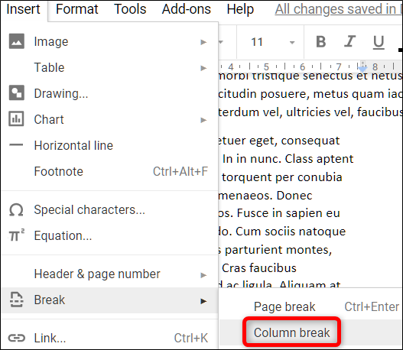
How to type in different columns in google docs
One option would be to press the enter key until you move to column two, but that takes too long.
The better option would be to follow these steps:
Put your cursor at the end of your text
Click the Insert Menu
Choose Column break
Now you can make changes to column one without affecting the line spacing in the other columns.

Slide 19
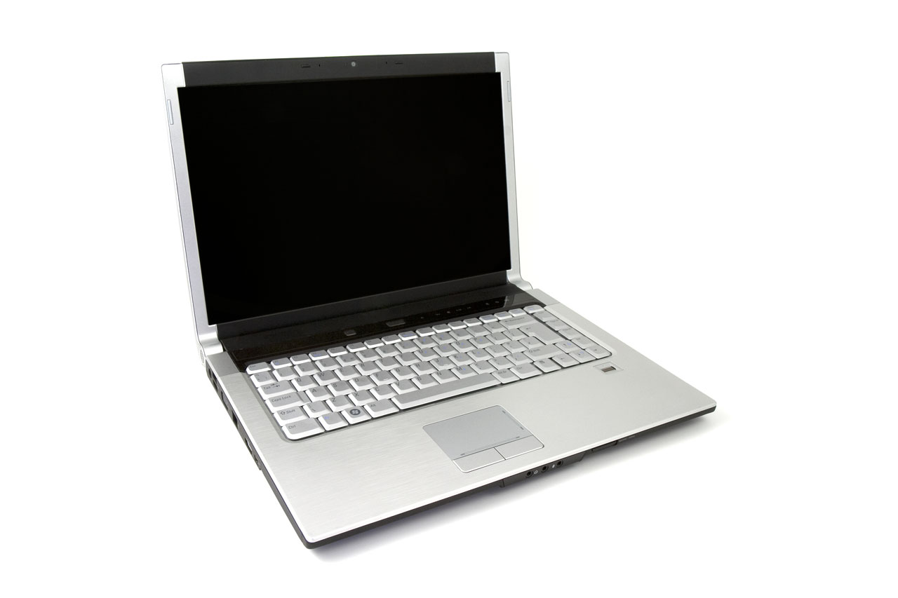
How to Use Voice-to-text in Google Docs
Typing with your Voice on your Computer:
Open a document in Google docs with a Chrome browser.
Click Tools > Voice Typing. A microphone box appears.
When you’re ready to speak, click the microphone.
When you’re done, click the microphone again.
Tips:
To have the most accurate typing remember to speak loudly and clearly.
The dictation software can sometimes pick up speech in the room so working in a quiet place can be very helpful.

Slide 20
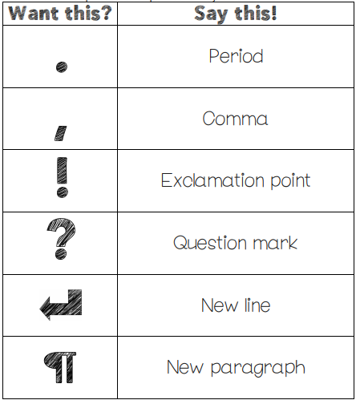
Adding Punctuation with your Voice

Slide 21
How to cite sources
You can easily cite sources without ever leaving Google Docs!
You can easily add footnote citations by using the Explore tool in Google Docs.
Step 1: Go to Tools > Explore (or click on the explore icon on the bottom righ)
Step 2: Type in your search query to find the source
Step 3: Hover over the result, then click on the quotations in the top right of the result
Step 4: A footnote citation will be added to the bottom of your doc

Slide 22
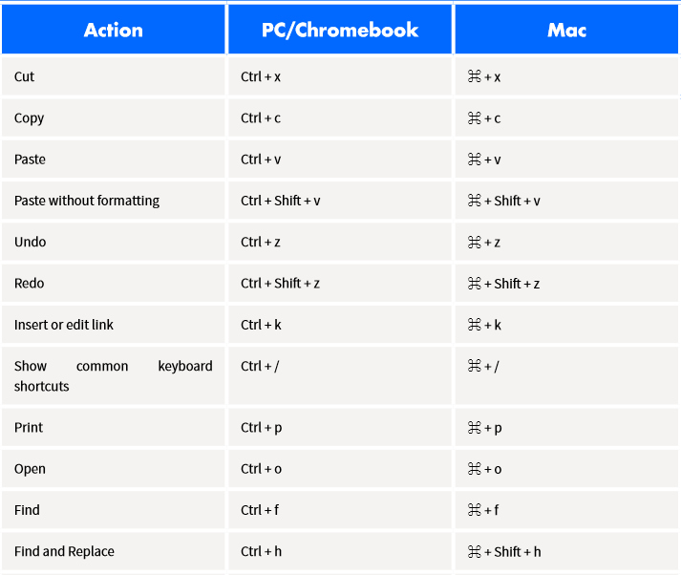
Google Docs Shortcuts

Slide 23
Google Docs Shortcuts

