Slide 4
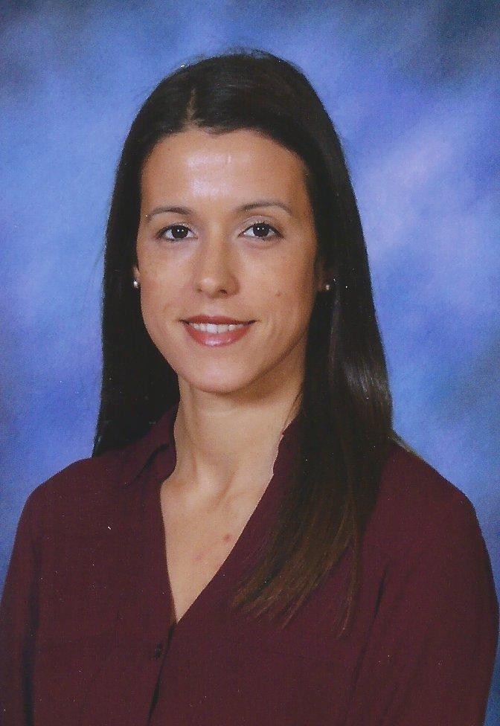
Type about you here.

Slide 5
I do not know how to swim.
My first language was English.
I have 2 boys.

Slide 6
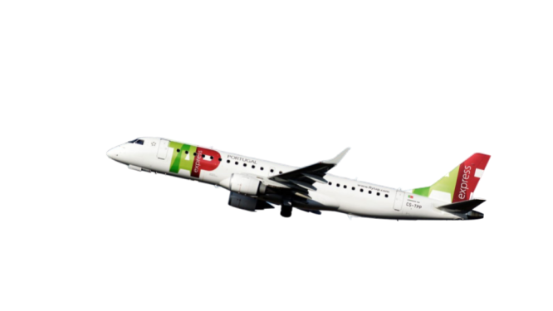
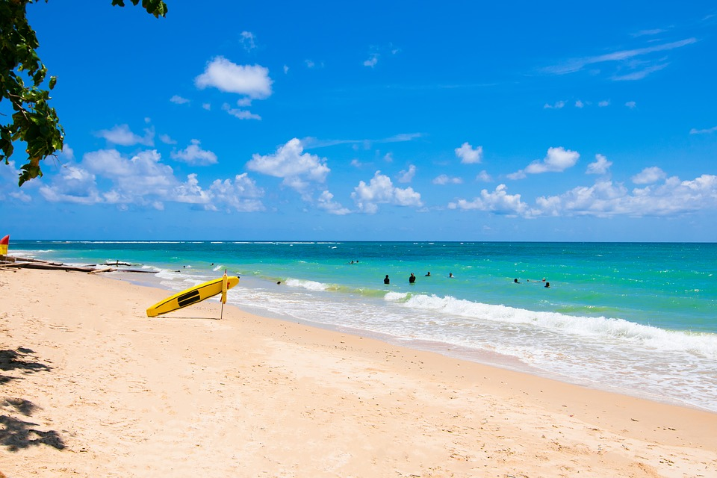
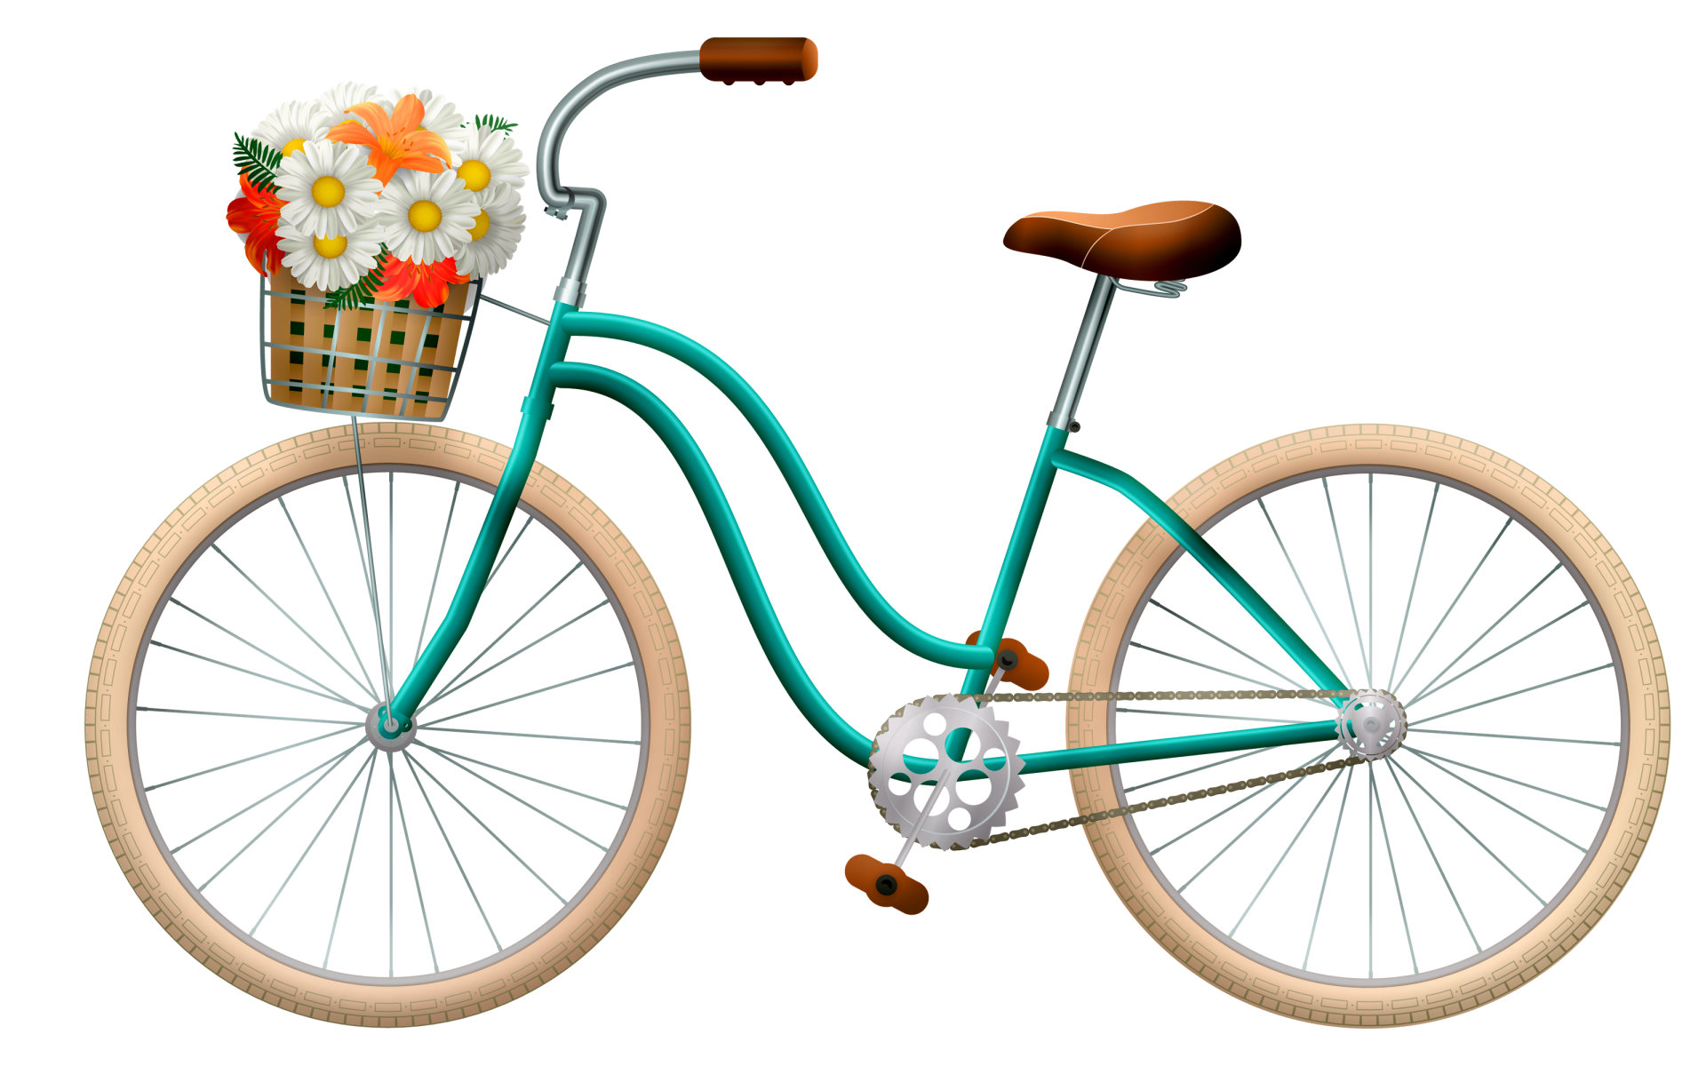
Delete this box and put in pictures of things you love or a video of you sharing some things you love.

Slide 8
spereira@nps.k12.nj.us
🏫
South Street School
44 Hermon Street
https://www.nps.k12.nj.us/SOU/
Type your phone number here.

