Slide 1
Remote Learning with Screencastify

Slide 2
What is Screencastify
Screencastify is an extension for chrome (it lives beside your omnibox) and interacts with you within your Chrome browser. It can be used to create videos of your screen as well as your voice, and can also embed your webcam in the video as well.

Slide 3
How to Get Started
Get the extension! Add it to your Chrome by clicking here
Once you’ve added it to Chrome, there are some set up steps that you’ll be prompted to complete
Give permission for Screencastify to access mic and camera, and access to your Google Drive (for saving your videos).
Click on the extension, and get started! Try out the different features, and explore all of the options.

Slide 4
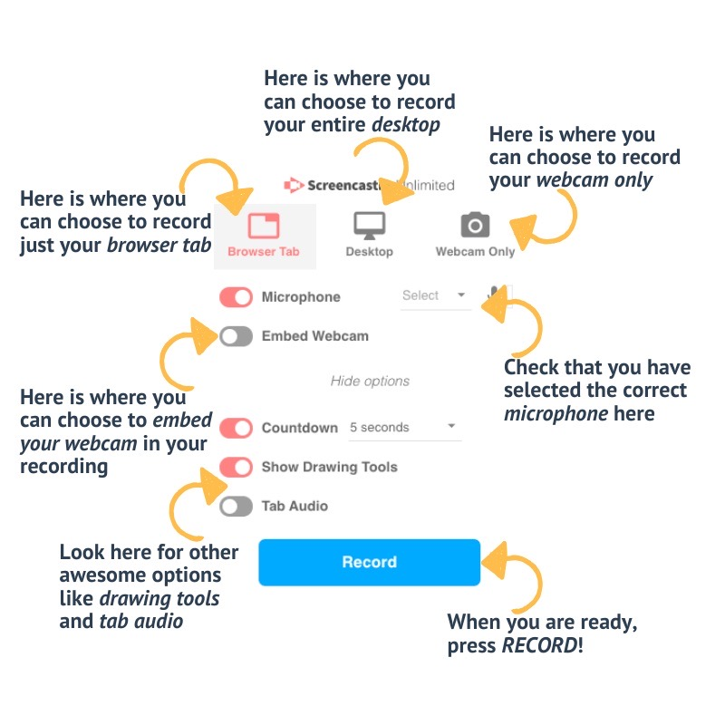
What type of recording will you choose?

Slide 5
The tab setting is used to record one single tab in a browser. The tab recording feature will only record the tab that you are currently in - viewers will not be able to see anything else on your screen.
The whole desktop setting would be used if you want to record more than one tab, or something else that is on your screen. Be sure to close anything that has private information so that you do not accidently record it!
The webcam setting is used to record you! You have the option to embed your webcam into the screen, or you can just choose to record yourself.
If you are recording yourself in your living room delivering a lesson on a whiteboard, then this is the setting you want!
If you are doing a slide deck, you may choose to embed your webcam so that your students can read your lips as you are speaking (especially important for English Language Learners, as they often rely on visual expressions, etc. to help them determine meaning.

Slide 6
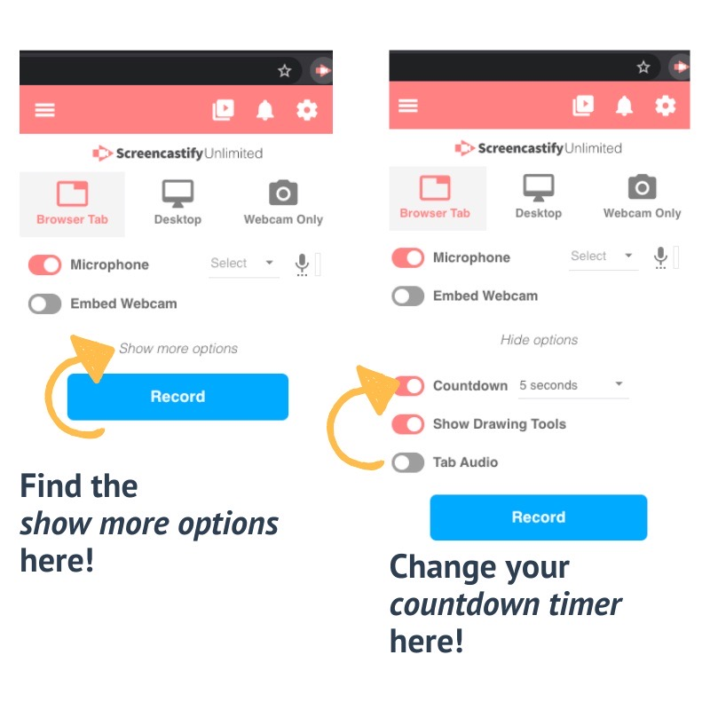
Countdown Settings
The default for the countdown before recording begins is 3 seconds. Trust me, this is NOT enough time! You have the option of 5 seconds or 10 seconds for a countdown.

Slide 7
Drawing Tools for Focus
Drawing tools can be enabled in the show more options section above the record button.
These tools include:
Pause - pause the recording; once you hit pause, you then have play (continue recording) or (end the recording) as options
Mouse pointer options:
Focus mouse - dims the screen, but highlights the area around your cursor
Hide cursor - hides the cursor when not moved
Highlight clicks - a colored circle appears around your cursor when you click
Pen with different colored options
Eraser (to erase pen marks that you make)
Embed webcam in case you want to include the webcam for part of the video (can also turn it off)

Slide 8
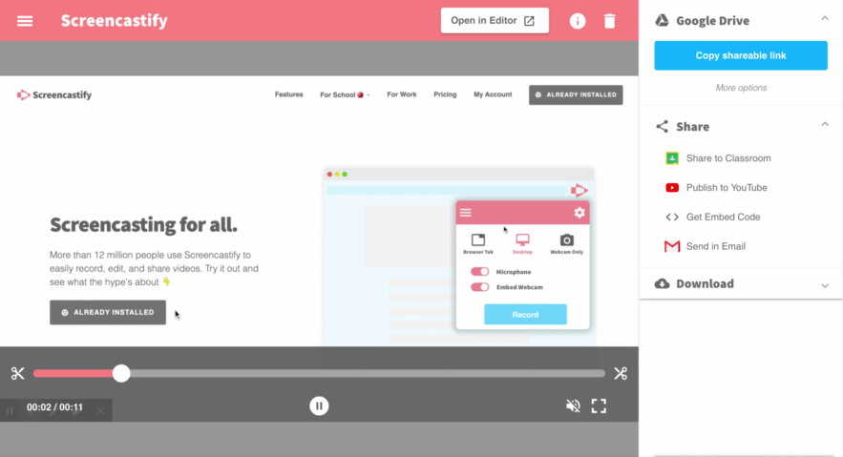
Trim and Edit your Video

Slide 9
Save your Edited Video

Slide 10
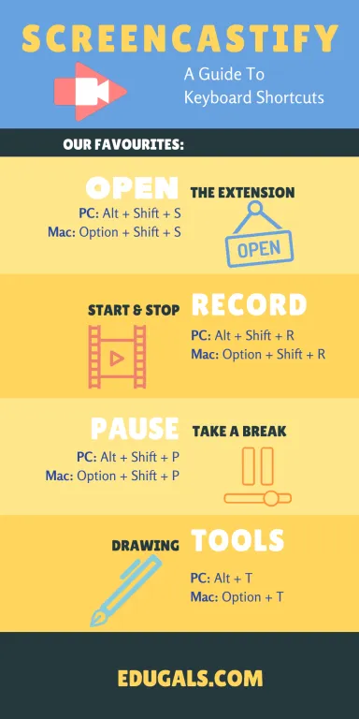
Screencastify Shortcuts
These keyboard shortcuts are extremely helpful when recording videos - they allow you to pause when needed, and keep you feeling calm and confident throughout.

Slide 11
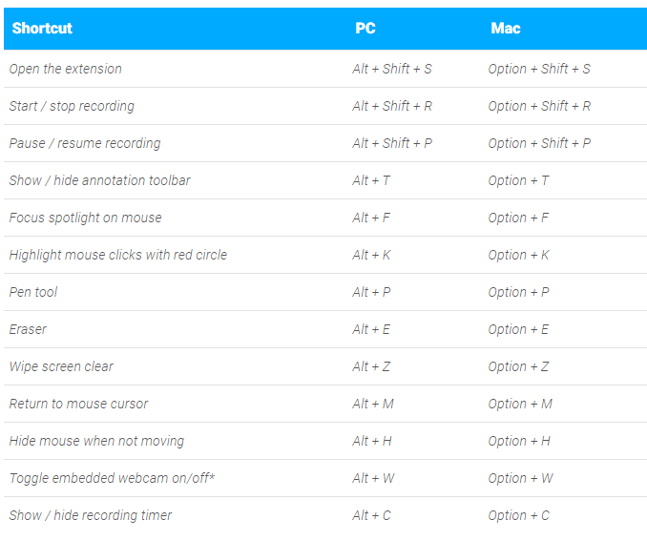
Here is a list of all possible extensions for both a PC or Mac.

