Slide 1
Summer Staff Orientation As we open summer school with two pilot locations, please be assured that your health and safety as well as our students is of paramount importance. We will be incorporating proven methods along with new DOE minimum standards as well as recommended considerations toward that end. This is an emerging, rapidly evolving situation and the NBOE will be following CDC updated information as it evolves, in addition to updated guidance from Executive Orders issued by the Governor’s office and the DOE Road Back protocols.
July 1, 2020

Slide 2
Ingress Procedure
Summer Staff Orientation
For all in-person Summer School Sites:
This location is a contactless summer school site.
All pick-ups and drop-offs will occur outside.
Only staff assigned to this location will be permitted in, barring any emergencies
Parents should ensure that anyone escorting their child to school is wearing a mask when picking up and dropping off their children.
Students should all have on masks when being dropped off for school.
A tent will be set up outside to receive students prior to entering the building.
There will be 3 stations to monitor the process: the lines to stand before you enter the tent, the tent where all screenings will take place, and the escorting of children into the building.

Slide 3
Ingress Procedure Cont’d
Summer Staff Orientation
Students will undergo a four step process prior to entering the building which includes the following:
Step 1: Symptoms Screening– Students will be asked a series of questions regarding their health. Depending on the students response, they will move to the next step in the process.
Step 2: Temperature Check - If the student passes the symptoms screening, they will then have their temperature checked. Students with a temperature of 100.4 degrees or higher, will not be permitted into the building.
Step 3: Footwear Sanitizing - Students will then stand in a rubber maid tub to sanitize and disinfect their shoes. Please note students must wear closed toe shoes).
Step 4: Hand Washing/Sanitizing - Students will be provided hand sanitizer or will wash their hands with soap and water before being escorted into the building.
Parents or anyone escorting their child are encouraged to assist in each step of this process.

Slide 4
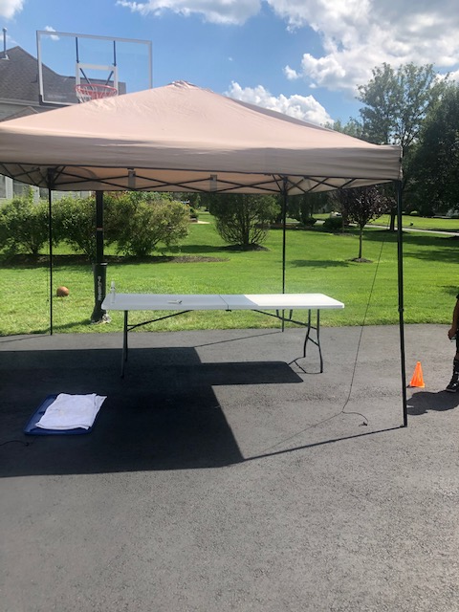
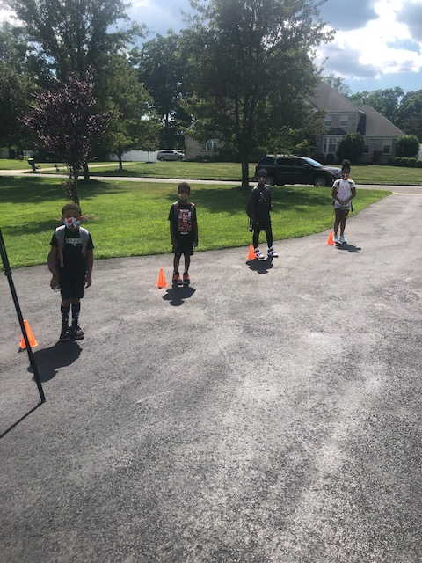
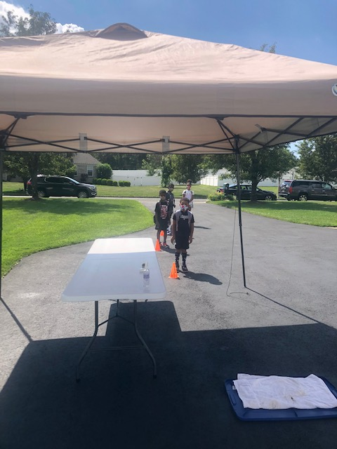
Summer Staff Orientation
Ingress Procedure Set-up

Slide 5
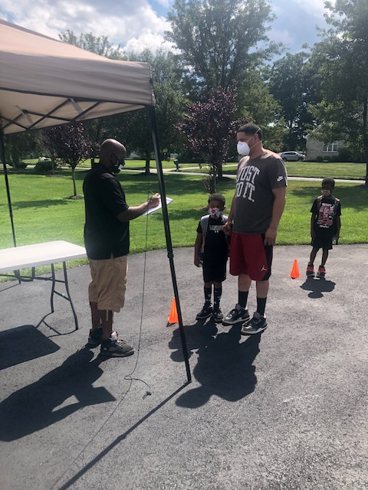
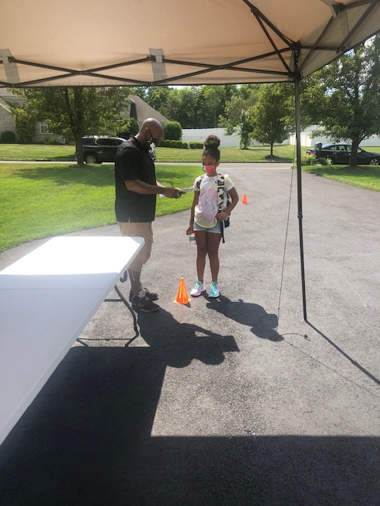
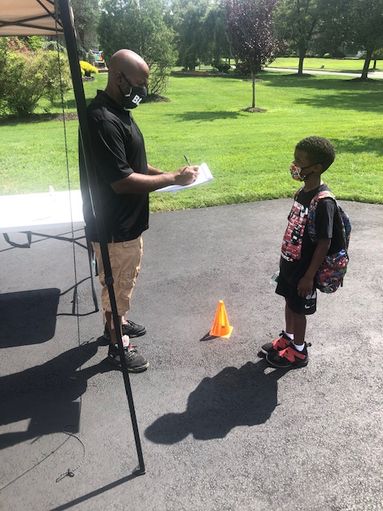
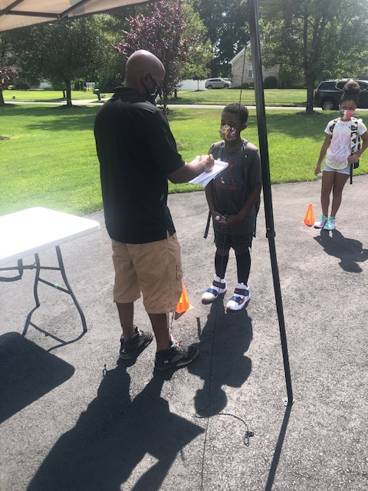
Summer Staff Orientation
Step 1: Symptoms Screening

Slide 6
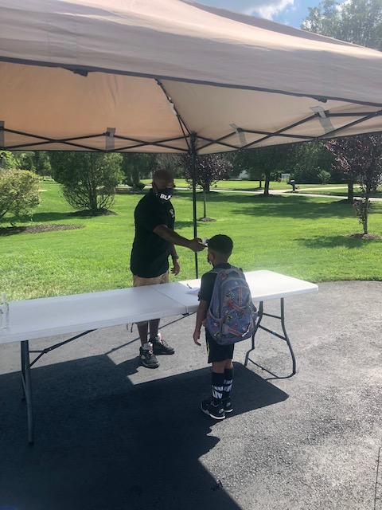
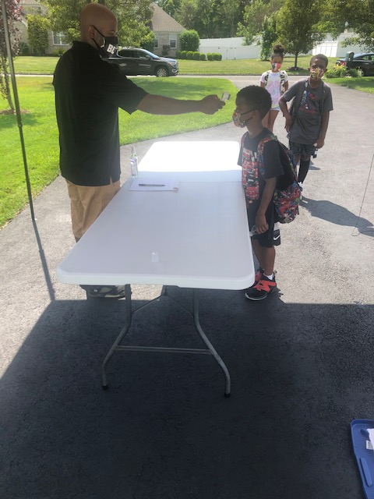
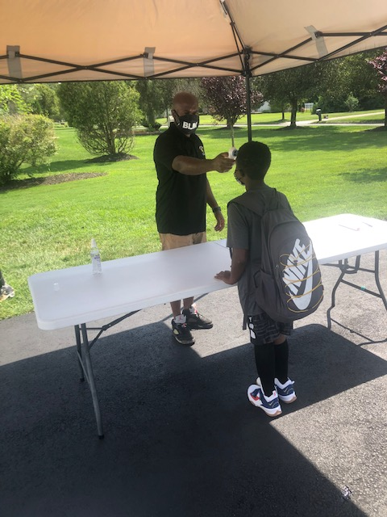
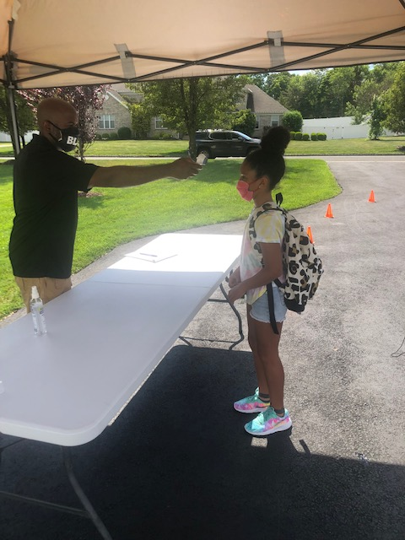
Summer Staff Orientation
Step 2: Temperature Check

Slide 7
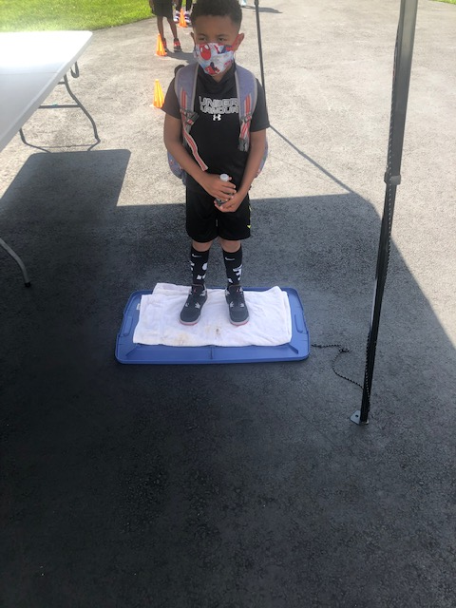
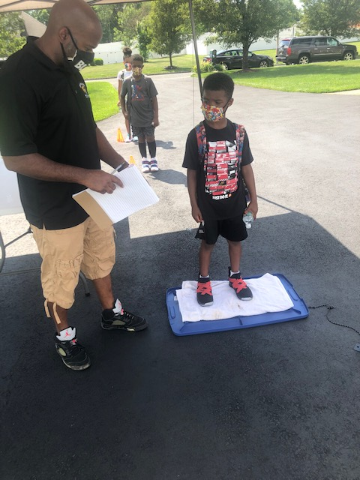
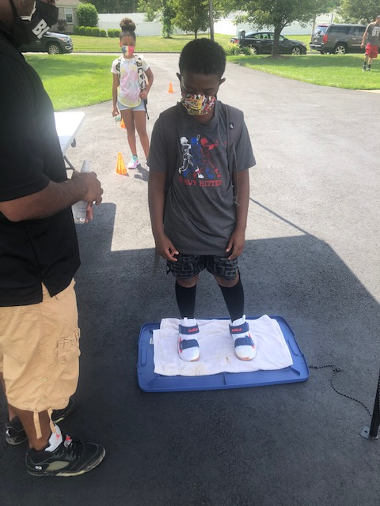
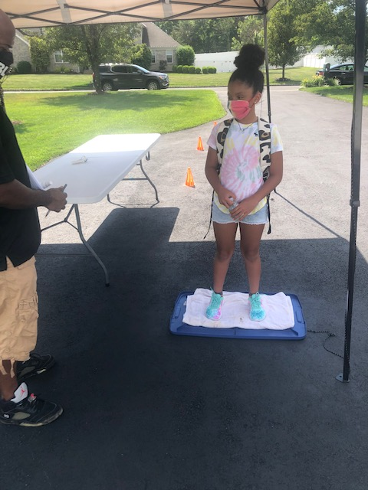
Summer Staff Orientation
Step 3: Footwear Sanitizing

Slide 8
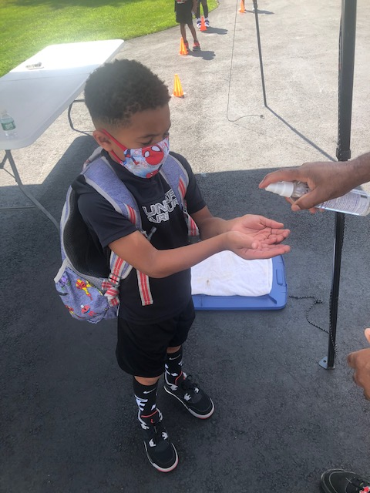
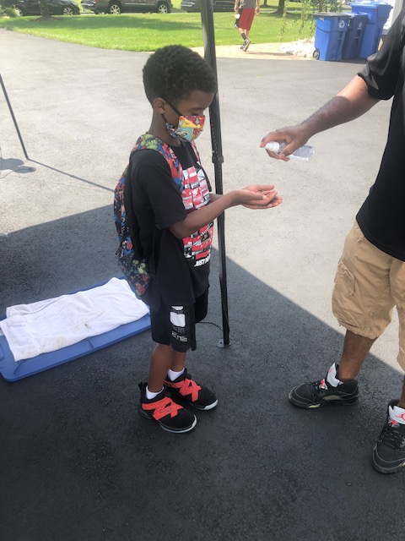
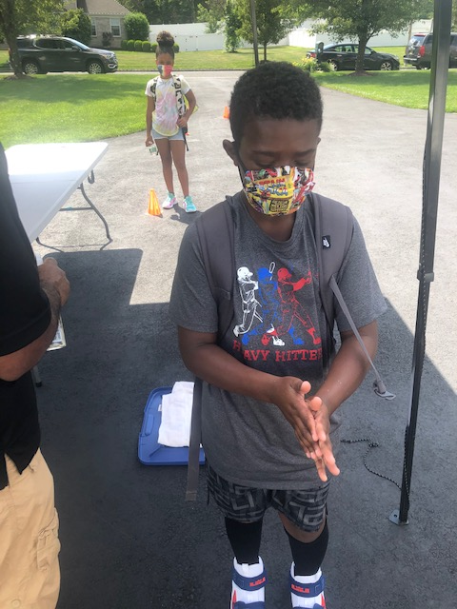
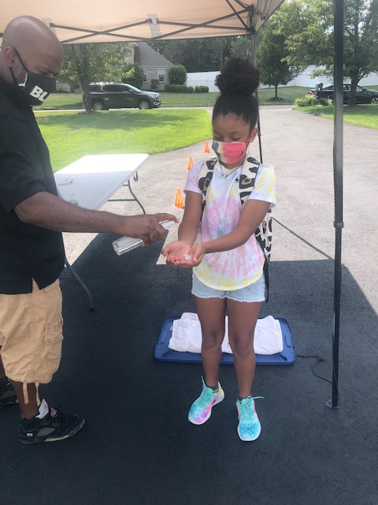
Summer Staff Orientation
Step 4: Hand Washing/Sanitizing

Slide 9
Cleaning & Sanitizing Protocols During COVID
CLEANING TOOLS AND PROTOCOLS

Slide 10
CDC , DOE & NJ Department of Health COVID-19 Guidance for school occupancies are being followed.
COVID-19: Information for Schools
Increase frequency of cleaning all surfaces, including walls (to the appropriate height based on age of students).
Routinely clean and disinfect surfaces and objects that are frequently touched.
Drinking fountains are being turned off, staff and students should bring their own water.
Cleaning/sanitizing checklist will be completed by the personnel responsible for the cleaning.
We will close off areas used by a sick person and not use before cleaning and disinfection.

Slide 11
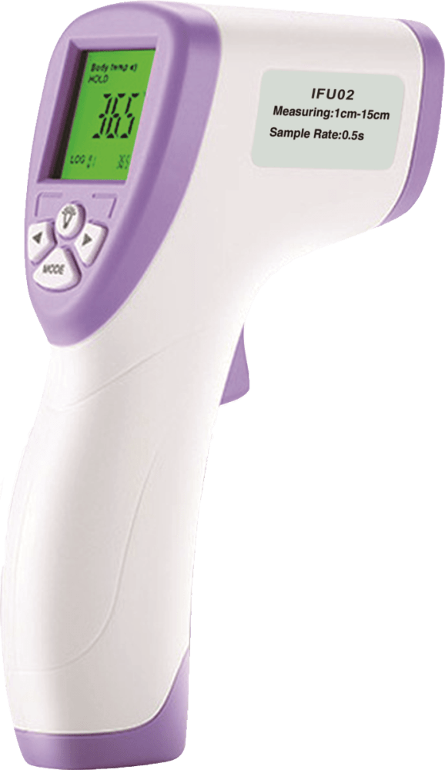
Re-Opening Disinfecting & Sanitizing Program
Due to the COVID Pandemic, Director Wali Thomas will have specially trained district staff utilizing specialized equipment and products to ensure proper sanitizing and disinfecting protocols up to district standards, CDC and DOE guidelines and recommendations are being met.
All surfaces will be cleaned with detergent/hydrogen peroxide cleaner or a product approved by the district for specific outbreaks, with additional dwell or contact to ensure sanitation.
Electrostatic equipment and misting sprayers will be utilized to ensure the efficacy of the program.

Slide 12
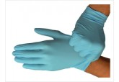
NBOE is responding to the COVID outbreak and is taking special action to ensure Summer Schools are safe for our students and staff.
While the district will implement measures and protocols to prepare for reopening, individual action and individual responsibility are necessary for the success of any measures implemented.
Not only should you take action to protect yourself and your families, you should also take action to prevent the spread of the virus if you or anyone in your family becomes ill.

Slide 13
Please follow signage – Do your part and talk to your students often about the importance of social distancing and hand washing.

Slide 14
Wash Your Hands Often & Use Sanitizer
Foaming Hand Sanitizer will be Available Throughout your school and in your classroom.
Kills 99.9% of germs
Contains TWO ACTIVE GERM-KILLING INGREDIENTS:
70% Isopropyl Alcohol (CDC, EPA Recommended Levels)
Benzalkonium Chloride
Encapsulated technology keeps alcohol active and working longer
Made with organic essential oils to keep hands moisturized.
Foam provides more volume compared to gel.

Slide 15
On-Going High Contact Surface Disinfecting
Computer Keyboards
Desktops
Doorknobs
Door Pulls
Drinking Fountain Bubblers and Faucets
Student Desks & Chairs
Elevator Buttons
Faucet Knobs
Fitness Equipment
Flush Valves
Hand Rails
Hand Towel Dispensers Levers
Lunchroom tables and chairs if used.
Locker Room Benches
Push Plates
Toilet Stall Doors and Latches
Bathroom fixtures
Kronos biometric readers
Light Switches
Telephone Handsets

Slide 16
Enviro Solutions 364
KILLS NOROVIRUS IN JUST 5 MINUTES!
One-step, fast contact-time disinfectant
Provides superior cost-performance benefits
Contains a neutral pH that is non-staining,
non-corrosive to equipment
Easily handled and does not dull floor finishes
EPA registered

Slide 17
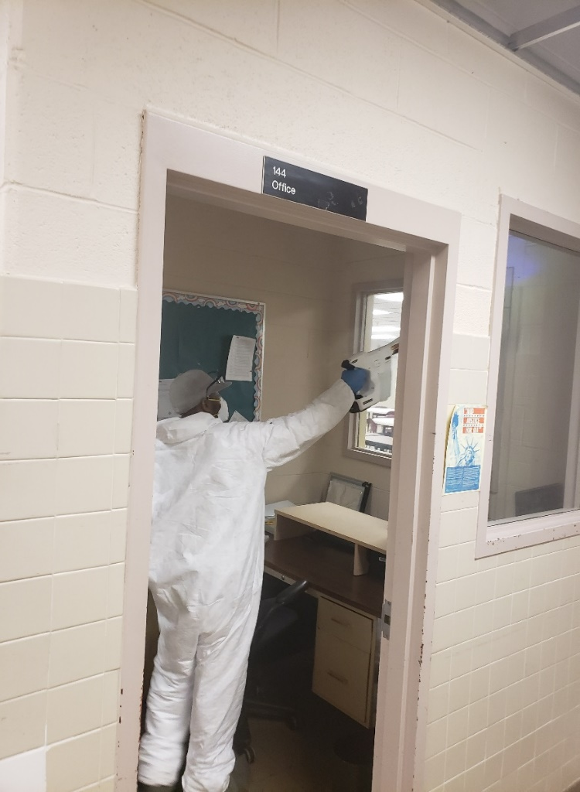
We are using Electrostatic sprayers for fast and efficient disinfecting

Slide 18
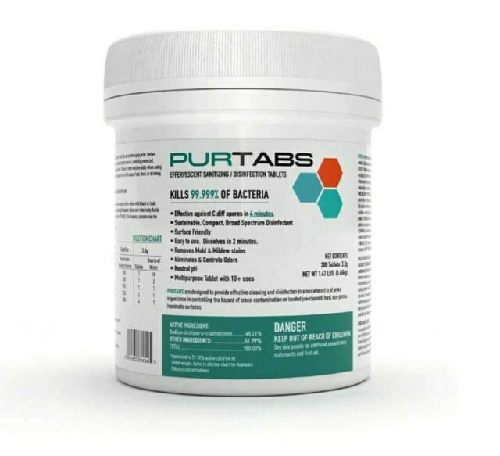
PURTABS VIRAL DISINFECTANT-HOSPITAL GRADE DISINFECTANT
Safer for people.
Deadly for infectious agents.

Slide 19
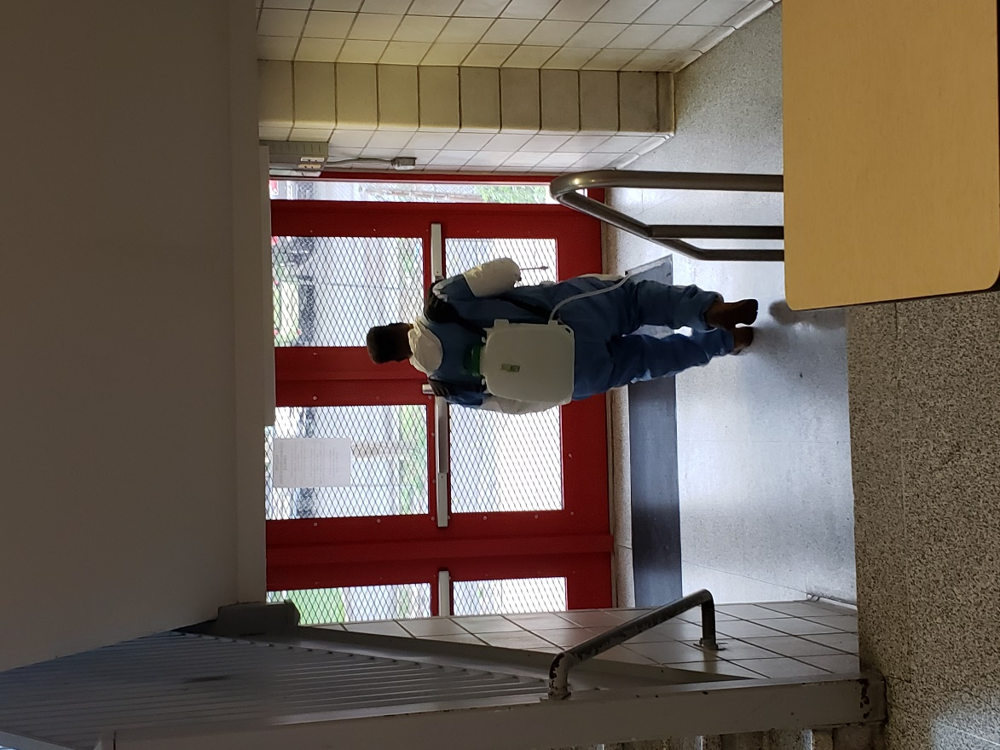
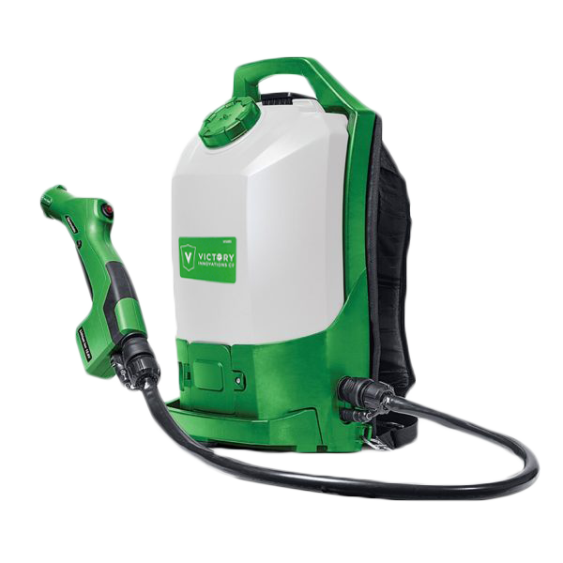
Backpack sprayers allow for speedy application of disinfectants.

Slide 20
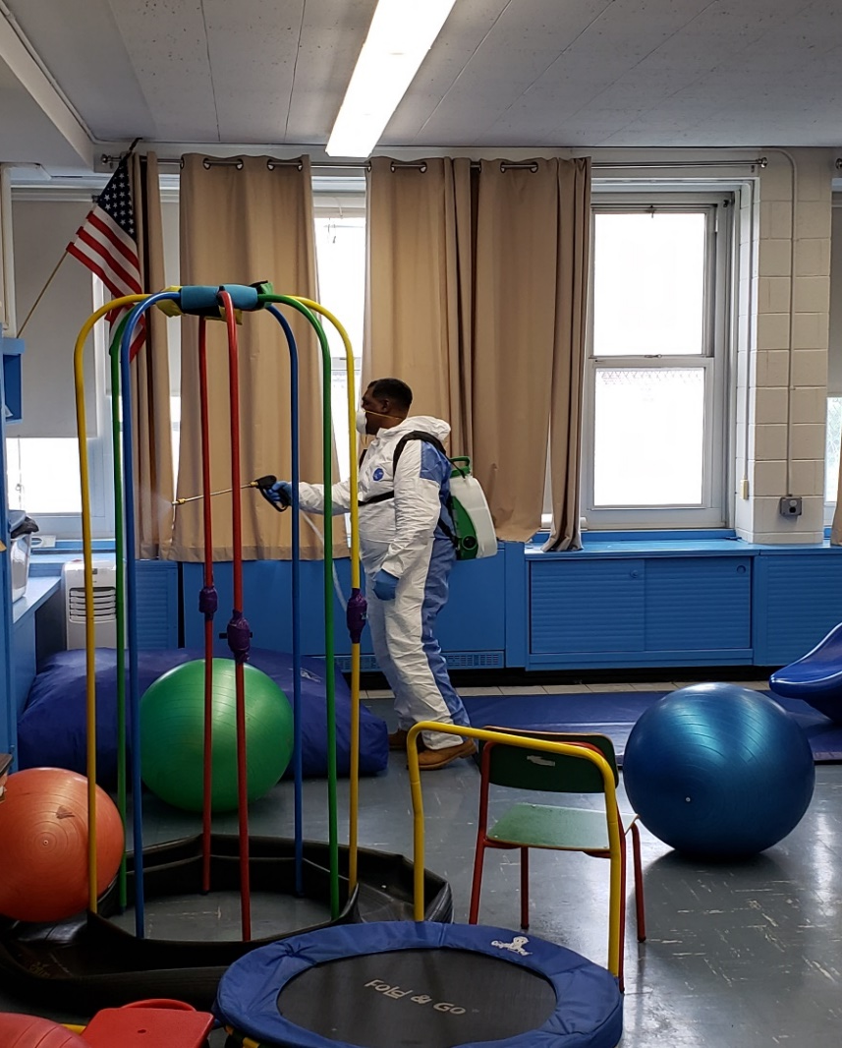
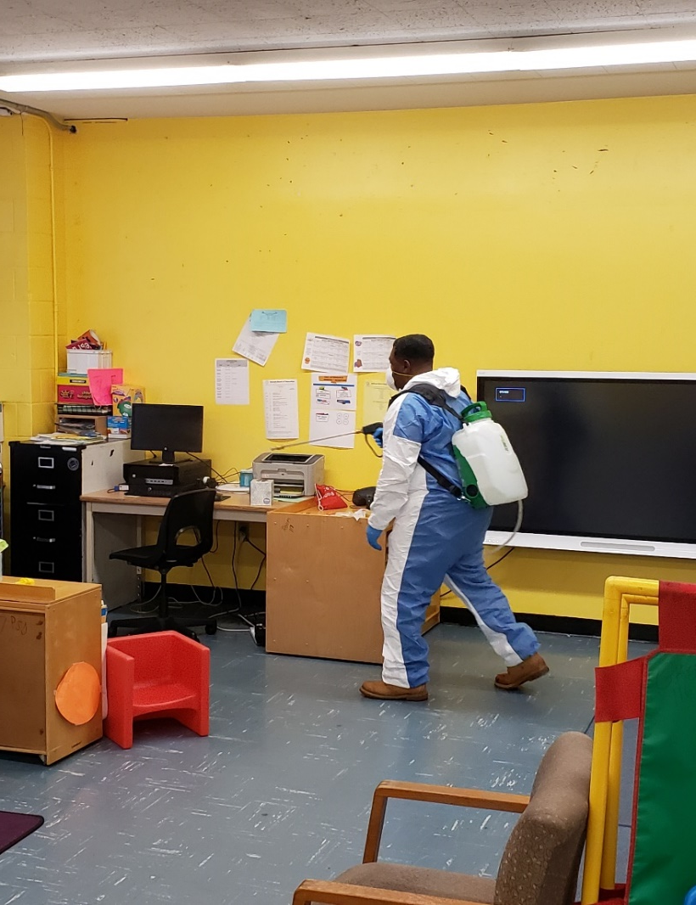
Use of misting sprayers to apply disinfectant.

Slide 21
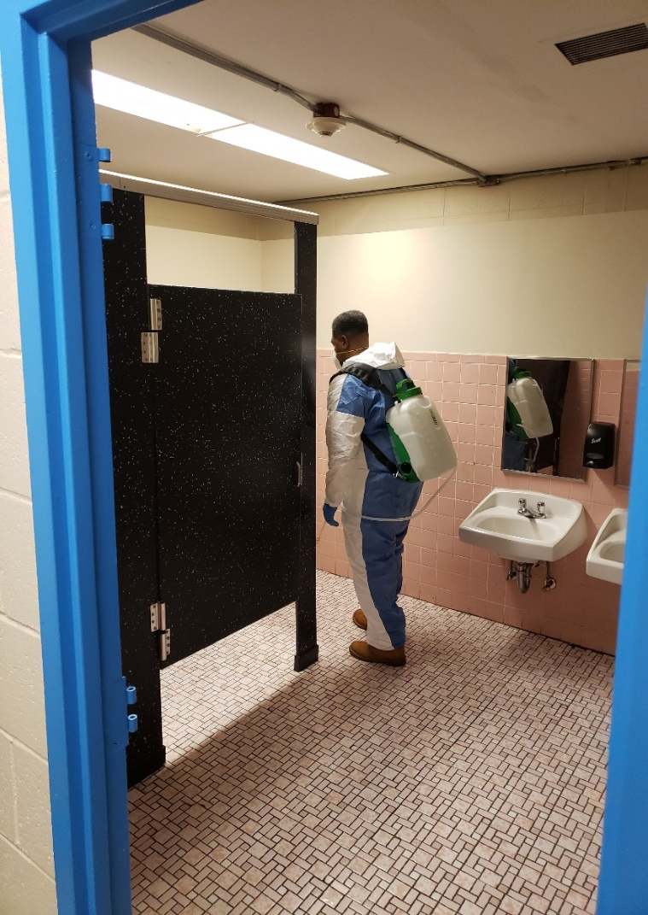
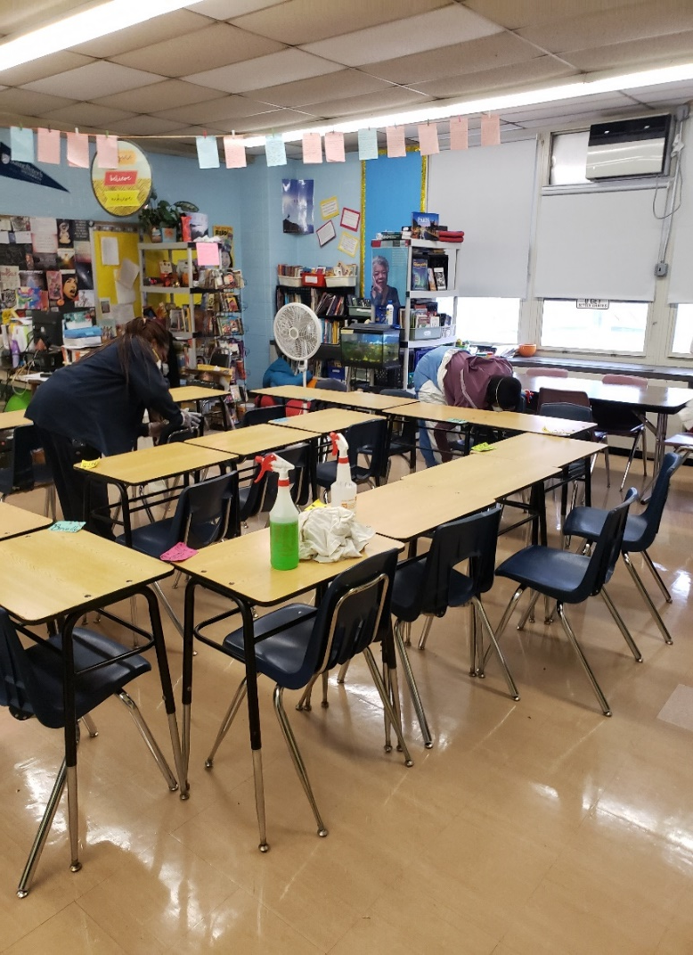
Automated equipment supplements hands-on contact cleaning.

Slide 22
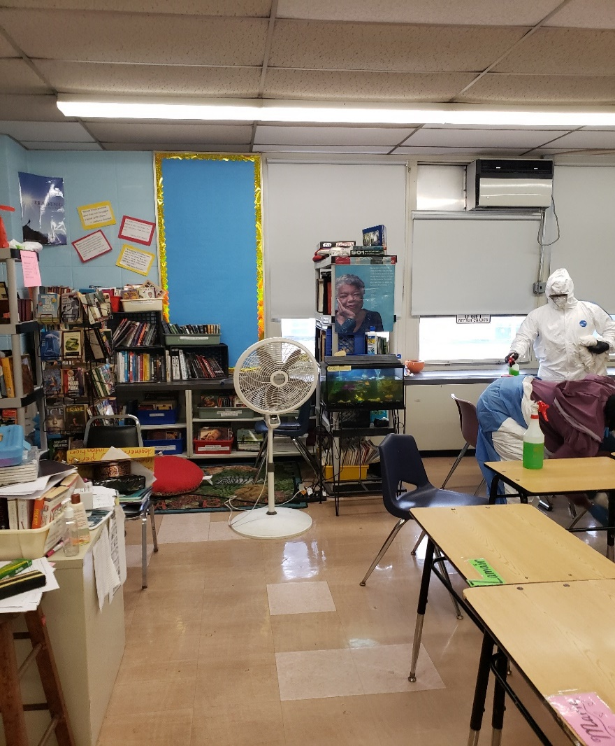
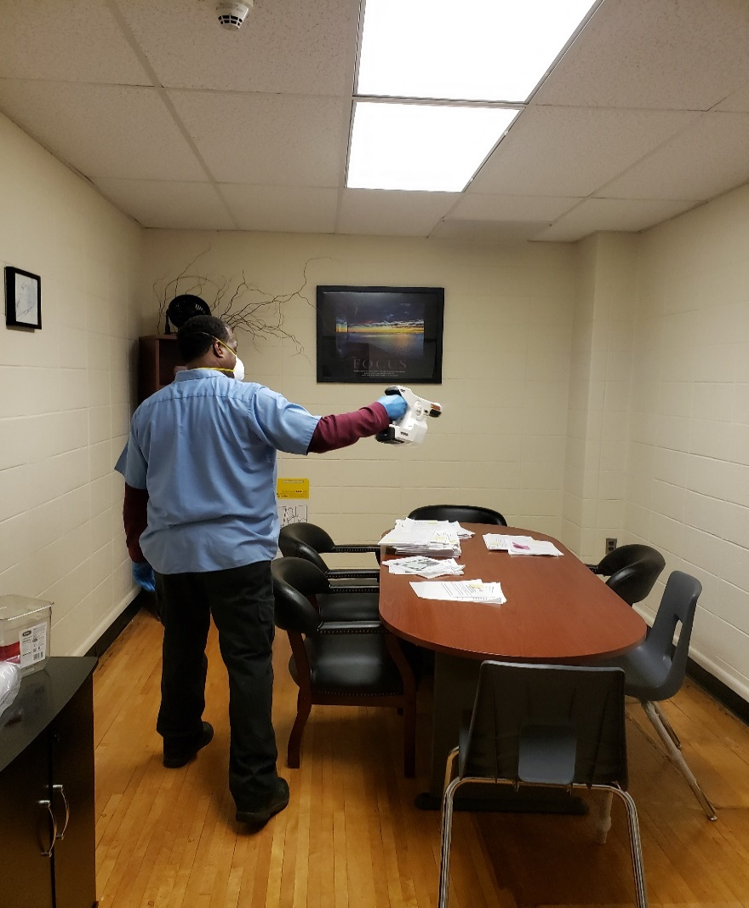
Electrostatic sprayers contact all surfaces by applying a positive charge to disinfectant.

Slide 23
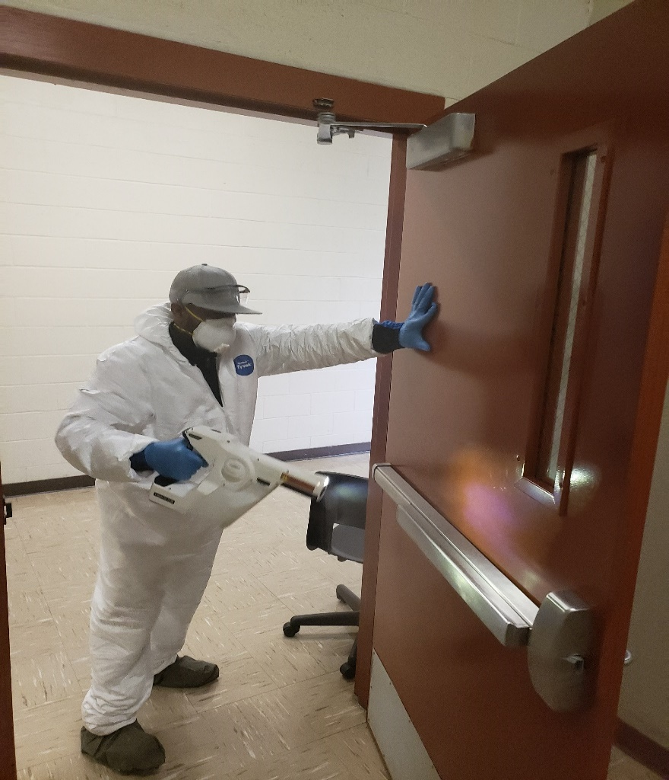
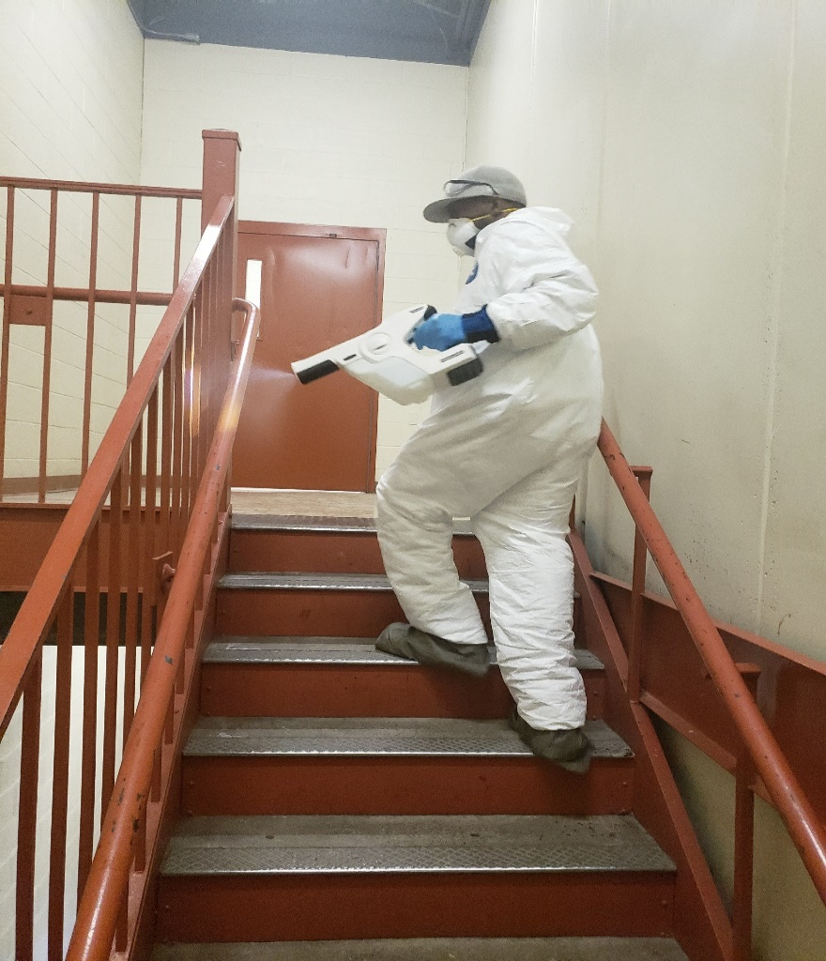
The entire building is treated quickly.

Slide 24
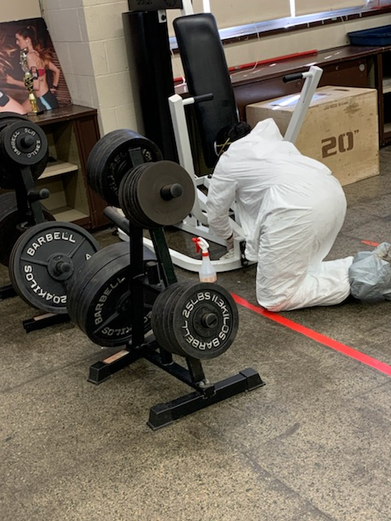
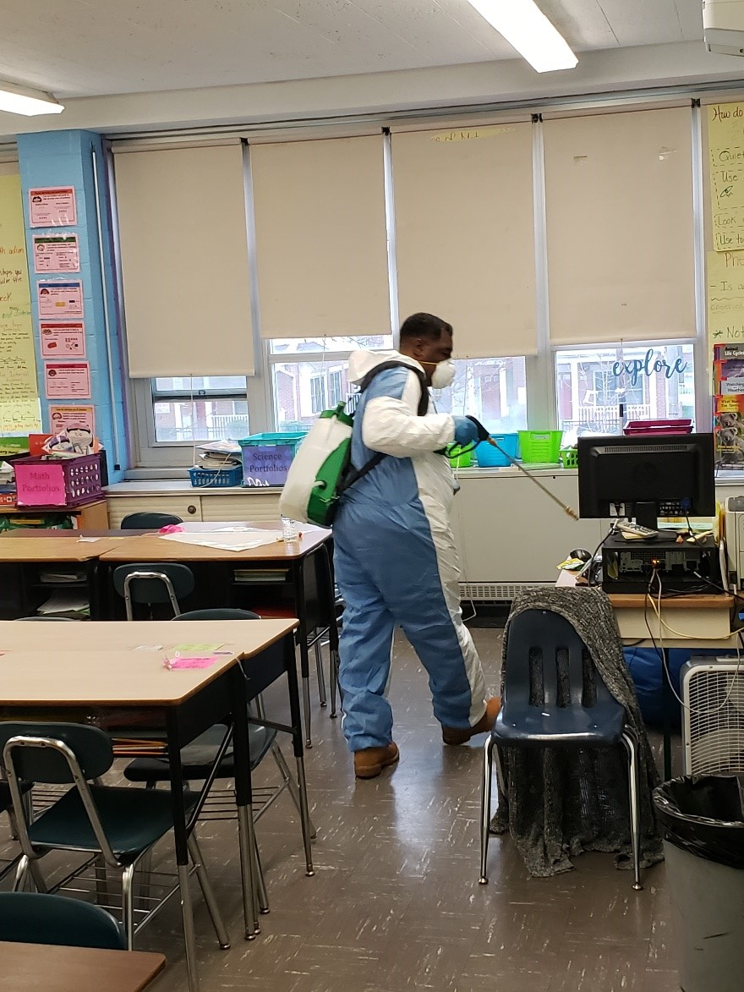
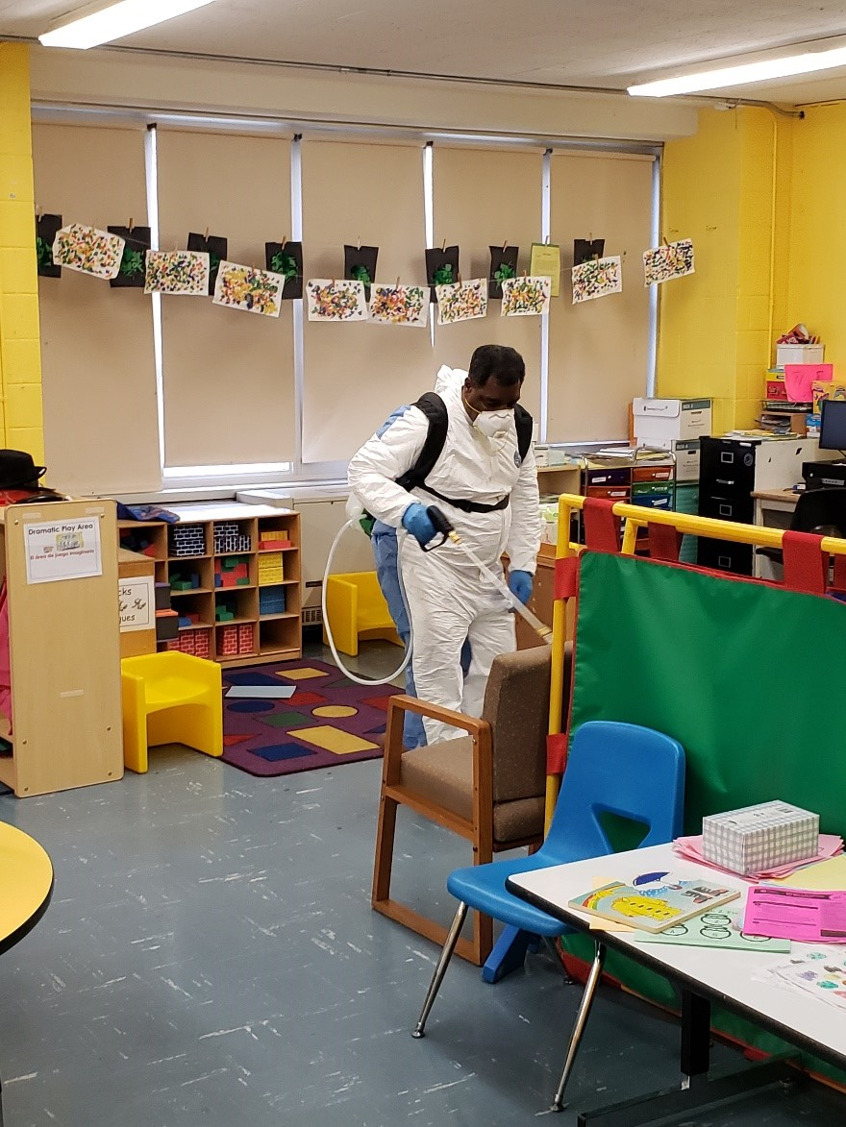
Continuous Disinfecting Program

Slide 25
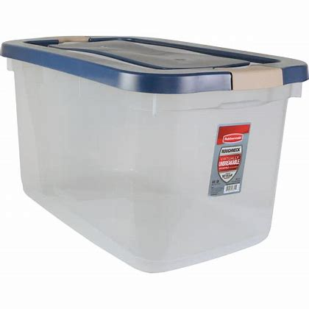
Every classroom will be supplied with a cleaning kit to help you keep your classroom tidy and sanitary during the school day.

Slide 26
So how do we know how we’re doing? 3M™ Clean-Trace™ Hygiene Monitoring System
Repeatability and reliability – two necessary aspects in any ATP testing system. In a study comparing 9 ATP systems, the 3M™ Clean-Trace™ Hygiene Monitoring and Management System was the only ATP system that produced acceptable results at all times and temperatures.

Slide 27
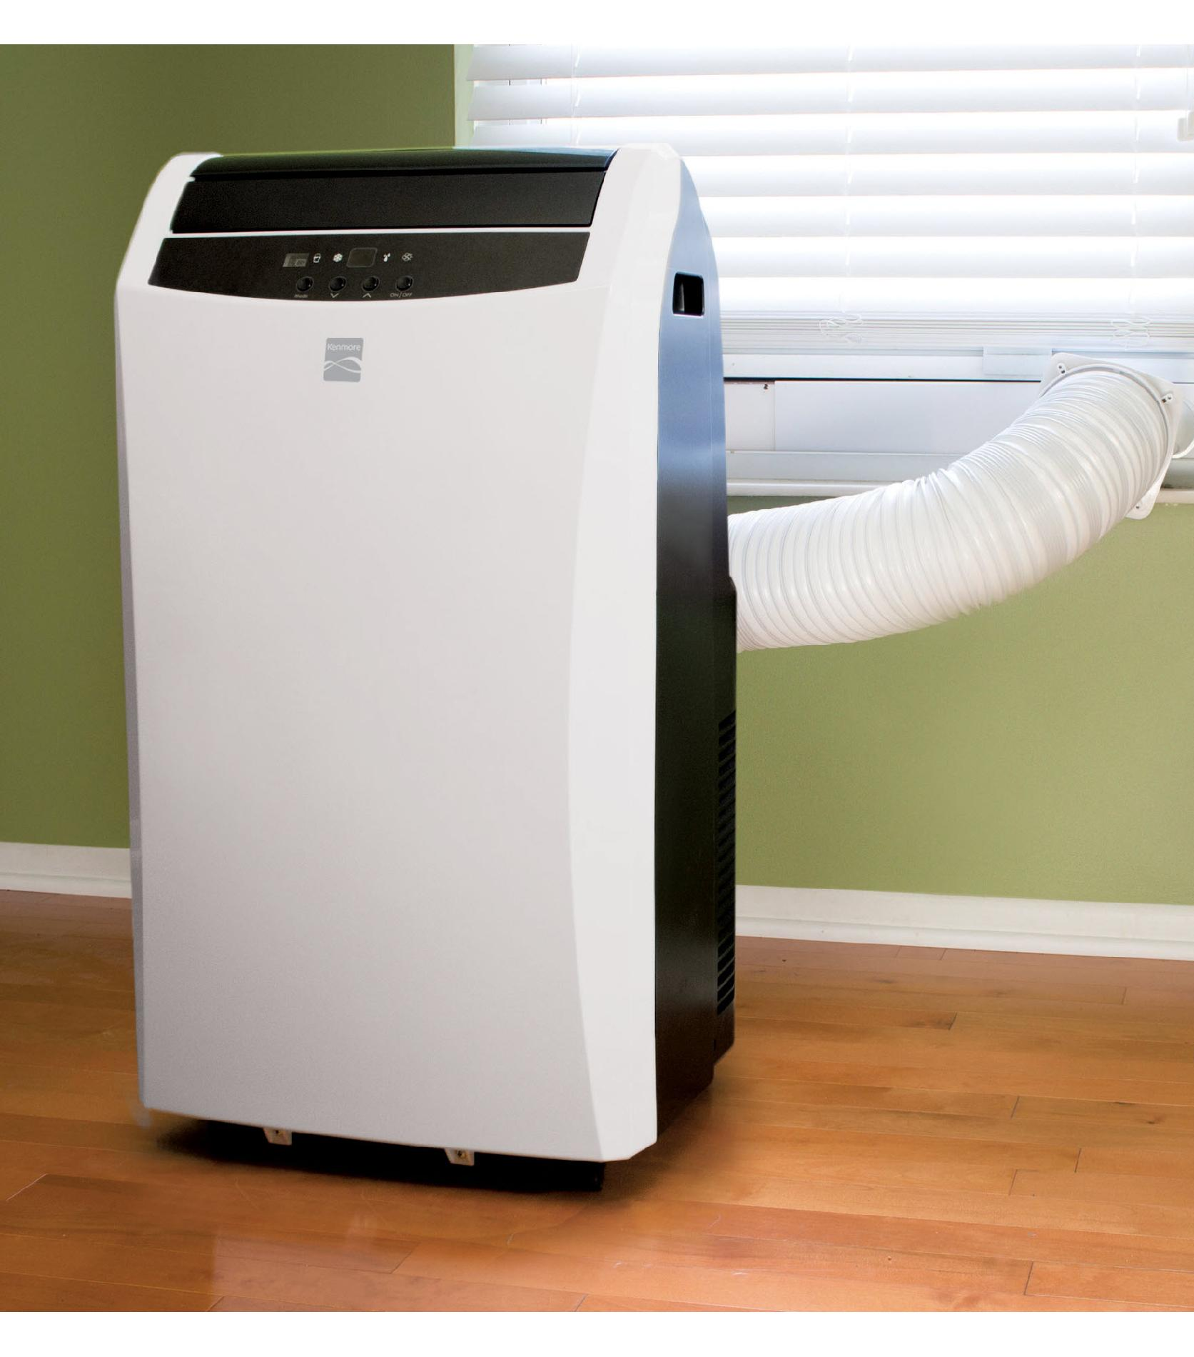
There is evidence that HVAC operations may help decrease people's exposure to airborne pathogens that spread COVID-19 and other illnesses.
NBOE has increased air ventilation by maximizing the introduction of fresh air and reducing air recirculation to the extent possible.
Air filter MERV ratings will be increased to improve removal of smaller particulates in the air stream.
Air filters will be changed more frequently.
Air handlers will be set to run 24/7 instead of non-occupied mode to continuously introduce fresh air into the building around the clock.
Staff are encouraged to keep windows open slightly to increase fresh air in air-conditioned rooms to the extent possible.
Portable A/C units are being deployed to 13th Avenue.

Slide 28
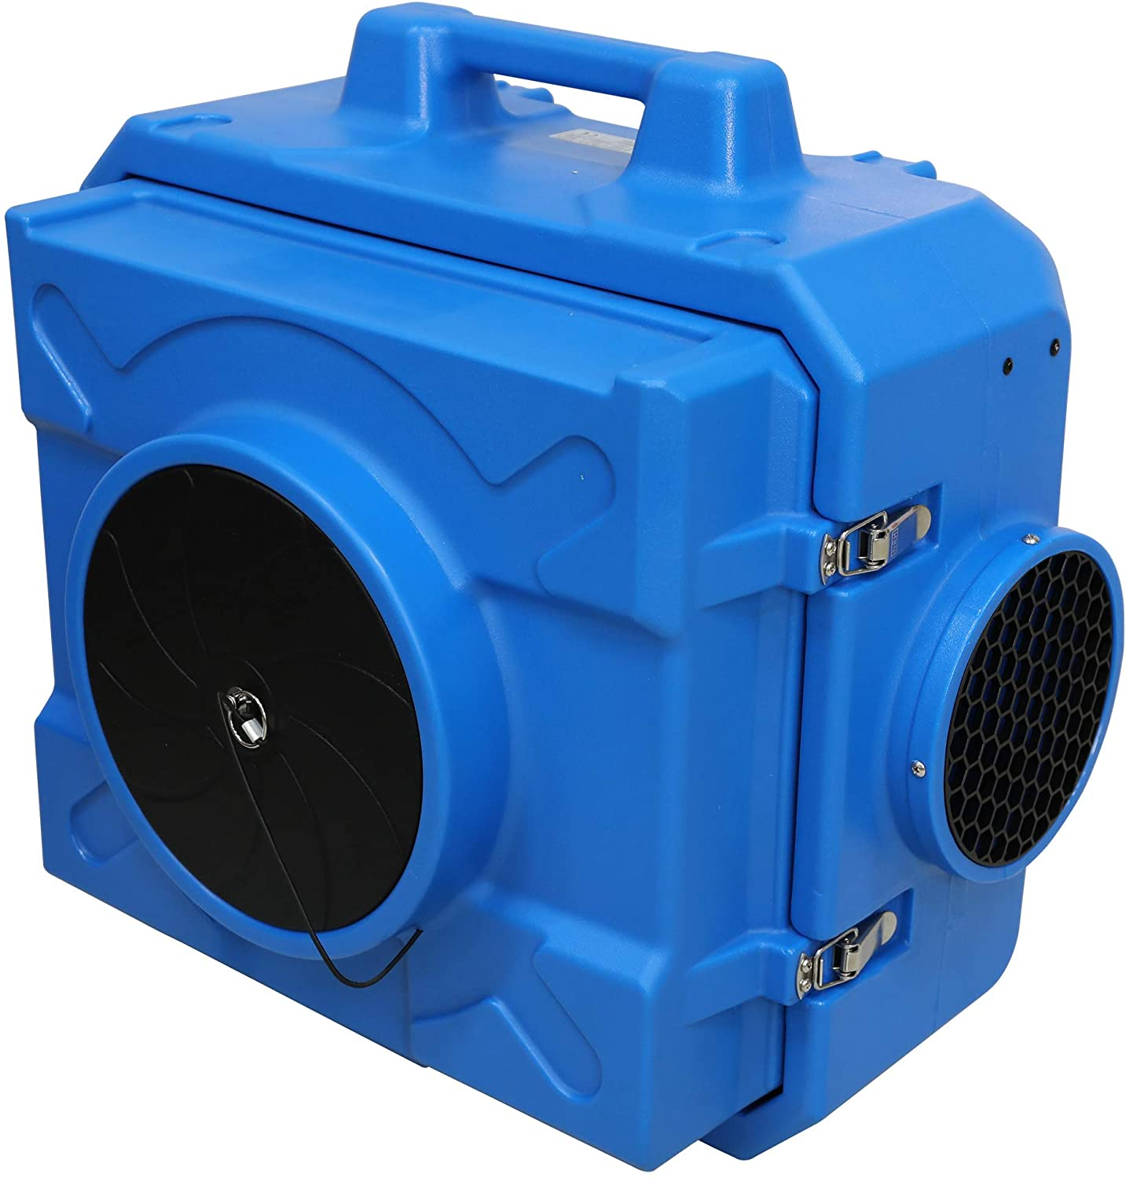
In the event a COVID positive individual is identified through testing, we will deploy Air purifiers with HEPA filtration as well as Hydroxyl Air Processors to treat specific locations.
The CDC believes the virus is mainly transmitted by person-to-person contact; however these units will be deployed if needed.

Slide 29
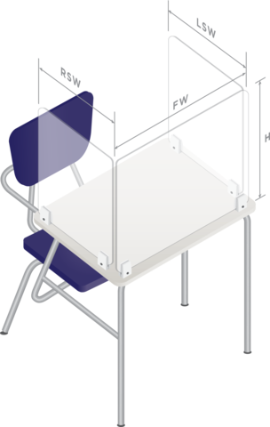
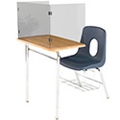
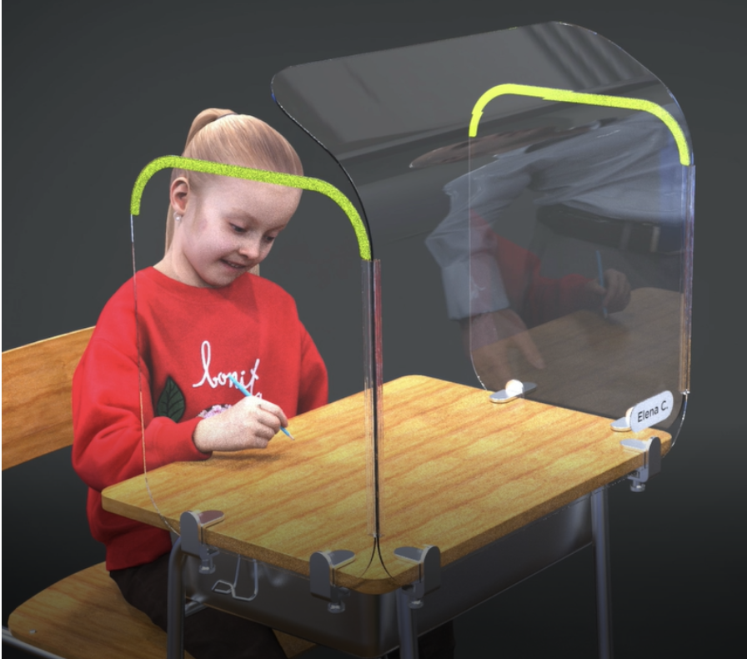
3-Sided Plastic Classroom Dividers for Desk - Also known as sneeze or cough guards, are optically clear plastic dividers which may be used to separate students in classrooms to help maintain social distancing. The NBOE is testing several prototypes and will be implementing as they arrive.

Slide 30
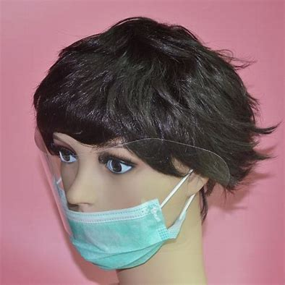
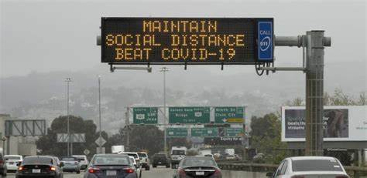
Mask-up, wash-up, maintain social distancing and do your part to limit the virus’s spread.
Practice routine cleaning and disinfection of frequently touched objects and surfaces, especially your smartphones.
Avoid using other employees’ phones, desks, offices, or other work tools and equipment, when possible. Clean and disinfect them before and after use.
Practice social distancing by avoiding large group meetings and maintaining distance (at least 6 feet) from others when possible.

Slide 31
Bloodborne Pathogens and COVID-19 Training
2020

Slide 32
Why should school employees be concerned about bloodborne pathogens?
#1 Blood from an infected person can potentially infect others:
- if sprayed or splashed into mouth, nose , eyes or on non-intact skin
- through needlesticks or cuts from sharp objects contaminated with an infected person’s blood
#2 The outcome of being infected with HIV, HBV or HCV is serious !!!

Slide 33
NJ PEOSH requires that public schools comply with the Bloodborne Pathogens Standard.
Copies of the PEOSH BBP standard and the required Exposure Control Plan are available in all the Nurses’ Offices.
District Bloodborne Pathogens Coordinator:
_Office of Health Services
Phone: _973-733-7150

Slide 34
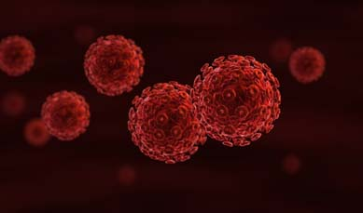
The Major Bloodborne Pathogens
--- infectious materials in blood that can
cause disease in humans
Human
Immunodeficiency Virus
Hepatitis B Virus
Hepatitis C Virus

Slide 35
Signs & Symptoms

Slide 36
S&S of Disease
Hepatitis
Lack of appetite
Vague abdominal pain
Nausea
Vomiting
Jaundice
Fever
AIDS
Swollen lymph nodes
Lack of appetite
Chronic diarrhea
Weight loss
Fever
Fatigue

Slide 37
Most exposures do not result in infection.
Risk varies according to:
Infectious agent involved
Type of exposure
Amount of blood
Amount of virus in source blood

Slide 38
Use of Needles and Medical “Sharps” in the Newark Public School District
Limited to disposal of insulin syringes in the Nurses’ Offices
All sharps must be placed in puncture-proof biohazard containers
District has evaluated and is using new “safe needle devices” to further reduce the risk of needle sticks –
- syringes with retractable needles

Slide 39
Chance of infection after a contaminated needlestick exposure
Virus Chance of Infection
HBV 6 – 30 out of 100 people
HCV 3 – 10 out of 100 people
HIV Less than 1 out of 100 people

Slide 40
Is there a vaccine to prevent infection?
Hepatitis B Vaccine
Hepatitis B? YES
Hepatitis C? NO
HIV? NO
Safe
90% effective
Series of 3 shots
given in the arm

Slide 41
Hepatitis B Vaccine
must be made available to
all employees with occupational
exposure within 10 days of
assignment – on work time and
at no cost to the employee.

Slide 42
Newark Board of Education Job Classifications with Occupational Exposure to BBPs
School Nurses & Physicians
Custodians

Slide 43
Occupational Exposure to BBPs
It is important that every school employee understands the dangers of infection and safe practices to minimize exposure.
The Newark Board of Education provides initial and annual training to all employees considered at risk of exposure.

Slide 44
Goals of Newark Board of Education’s Exposure Control Plan
#1 Prevent exposures
#2 Treat exposures that do occur in a timely way according to the latest CDC guidelines

Slide 45
The most effective practice for preventing exposures and reducing transmission of infectious agents?
Handwashing !

Slide 46
Practice “Universal” or “Standard” Precautions
#1 Treat all blood and the following
body fluids as if potentially infectious
Blood products
Fluids surrounding brain, spine, heart and joints
Any body fluid visibly contaminated with blood
Fluids in the chest and abdomen
Fluid in the uterus of a pregnant woman
#2 Tears, saliva, sweat, vomitus, urine and
feces do not pose a BBP risk unless
they are contaminated with blood.

Slide 47
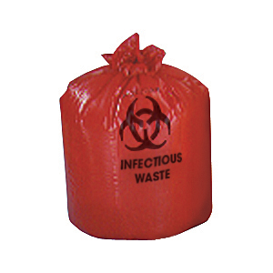
Use methods to contain or remove the hazard at the source:
Safe needle devices that cover or retract the contaminated sharp “before” an exposure can occur
Puncture- resistant containers for sharps are maintained in the nurse’s office of each school
Appropriate containers for materials saturated with blood

Slide 48
Are paper towels or latex gloves containing a few drops of blood considered regulated medical waste in NJ?
NO.
“Paper towels or gloves that are not saturated with blood or a regulated body fluid and are not either dripping and soaked in or have dried or caked after having been saturated with such fluids are not regulated medical waste.”
www.state.nj.us/dep/dshw/rrtp/mwforms03/mwtrqasht.htm

Slide 49
Follow on-the-job procedures designed to reduce exposure
#1 Have specific employees assigned to deal with BBP hazards
- First aid by school nurse or person trained in BBP safety
- Custodian responsible for blood and body fluid spills
#2 Wear protective gloves when rendering first aid;
wash hands immediately after removing gloves
#3 Do not eat or drink in areas where there is a
reasonable likelihood of exposure to blood or body fluids.
#4 Dispose of needles and sharps in puncture-proof biohazard
container; Use safe needle devices whenever possible

Slide 50
Provide / Utilize Personal Protective Equipment
PPE Available | Location
Medical Gloves | Nurses’ Offices Custodians’ Office Closets Every classroom has a kit which contains: gloves, 4x4 gauze, band-aids.
Utility Gloves | Custodians, grounds and maintenance closets
Gowns, face shields, masks | - Nurses’ Offices

Slide 51
Housekeeping
Contaminated surfaces can be a source of exposure, particularly to the Hepatitis B Virus which can survive for 7 days.
Clean and decontaminate all equipment and environmental surfaces which have been contaminated with blood or other potentially infectious materials
If using bleach solution, ratio is 1 part bleach to 10 parts of water; cannot be kept longer than 24 hours.

Slide 52
Newark Board of Education Procedures Following an Exposure
#1 Wash area with soap and water.
#2 If eyes or mucous membranes are
involved, flush with copious amounts
of water.
#3 Immediately report the exposure to the
school nurse; if nurse not present,
report to building principal.
#4 Make sure that an “Employee Exposure
Report Form ” is completed.

Slide 53
PEOSH requires that the District provide employees with post-exposure evaluation and follow-up.
This should happen within hours (not days) of the exposure.
School Nurse will make arrangements with Concentra Clinic.
Health care provider must follow the latest US Public Health Service Guidelines for treatment, testing and follow-up (copies available in the Nurses’ Offices).

Slide 54
Medical Information about Treatment is Confidential
The District is entitled to receive only the
following information from the treating
health care professional:
That the employee has been informed of
the results of the evaluation
That the employee has been told about any medical conditions resulting from the exposure which require further evaluation and treatment

Slide 55
For questions about the Newark Board of Education’s Bloodborne Pathogens Exposure Control Plan
contact:
Your School Nurse or The District’s Bloodborne Pathogens Coordinator:
For questions about the District’s compliance with the
PEOSH Bloodborne Pathogens Standard,
contact PEOSH at: 609-984-1863

Slide 56
What will Students Be Learning In Summer School?
Rising 1st Graders: Phonics, reading, writing with an emphasis on general knowledge, and mathematics
Rising 2nd and 3rd Graders: Phonics, reading, writing with a focus on science content and mathematics
Rising Grades 4-8: Language arts literacy with an emphasis on writing and social studies, and mathematics
Every student will receive a learning kit (notebook, pencils, crayons, markers, ruler, protractor, scissors, glue, watercolor paints, watercolor paper, construction paper).
The kits will be issued to individual students for their use only.
Software: Lexia Reading and iReady Mathematics will be used in the instructional program and available to all students.

Slide 57
How Will Students Be Supported?
At the school site the following professionals will be supporting your child: Principal, two school nurses, school counselor, classroom teacher and Academic Interventionist.
Each morning will begin with a Social Emotional Check-in by the teacher.
All staff and students will practice these five Social and Emotional Practices:

