Slide 1
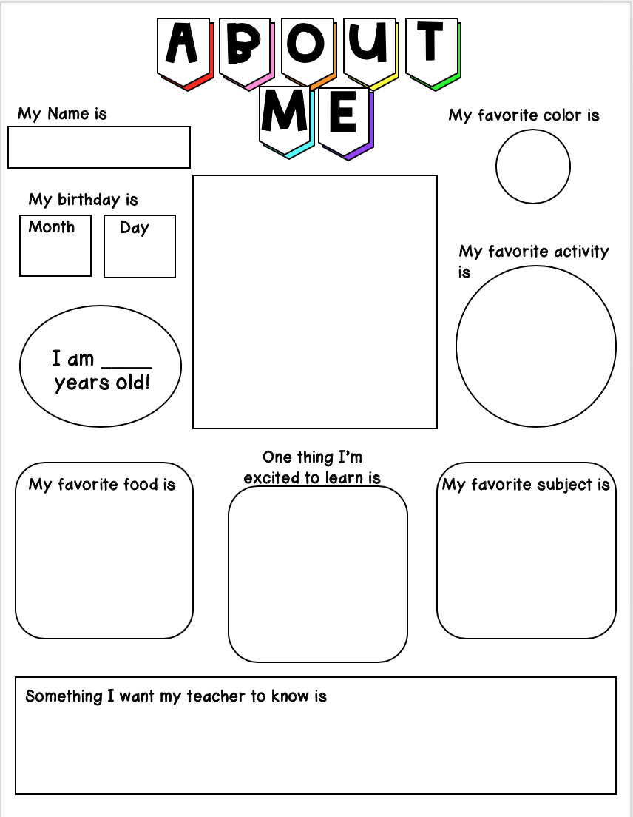
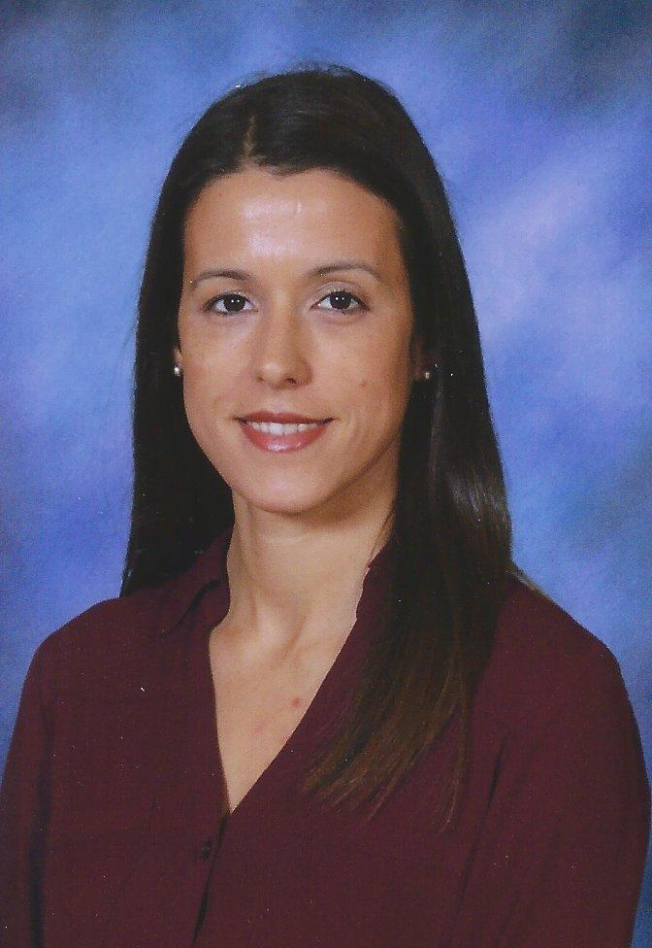
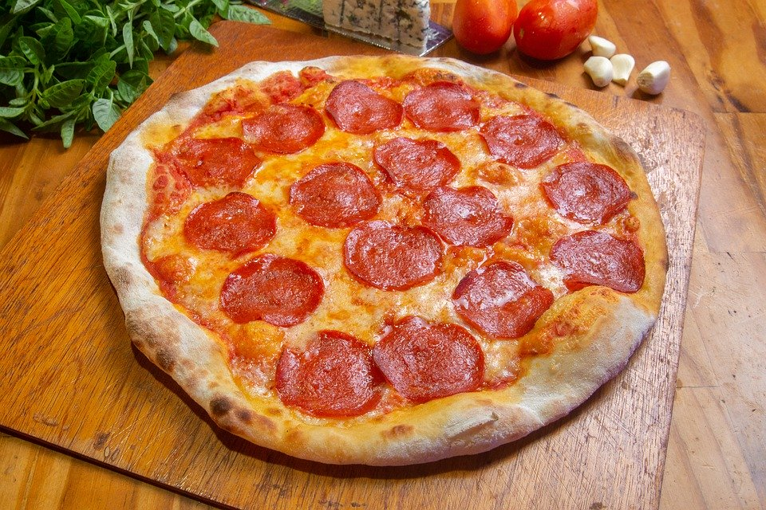
Mrs. Pereira
7
29
?
I want my students to know that they can achieve anything they set their mind to! I am so excited to be your teacher this year!

