Slide 1
Webex
WORKSHOP
By: Silvia Pereira

Slide 2
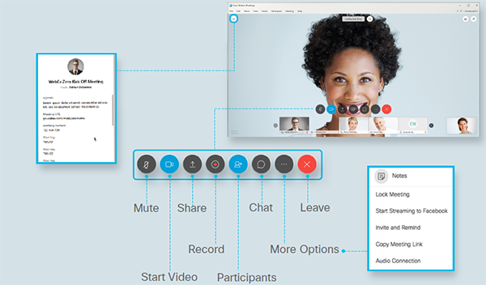
Webex main page

Slide 3
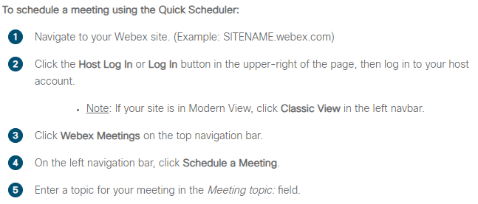
How to schedule a meeting

Slide 4
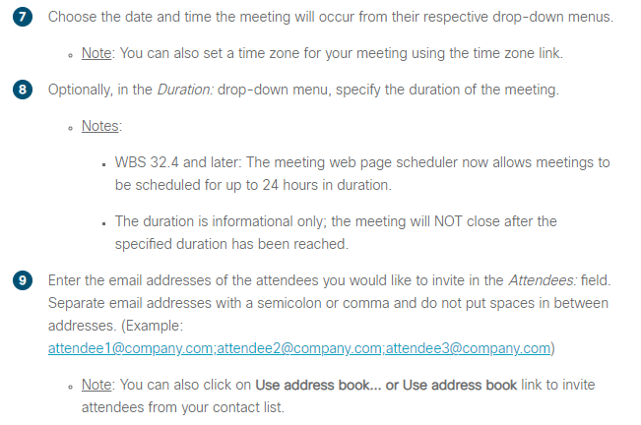
How to schedule a meeting

Slide 5
How to schedule a meeting

Slide 6
How to start or stop your video
As a host your video will automatically go on when you start your webex session.

Slide 7
Mute or unmute others as a host on webex
As a host, you can mute anyone at any time during the meeting or before they join. Hosts can mute individual participants or the entire group.

Slide 8
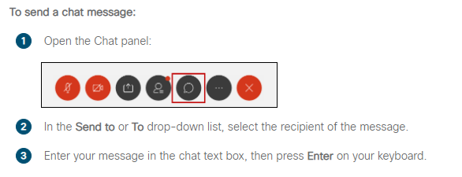
How do I send a chat Message?
During a meeting or event, that presenter can specify chat
Privileges for participants. These privileges determine to whom
Participants can send chat messages.
Solution:

Slide 9
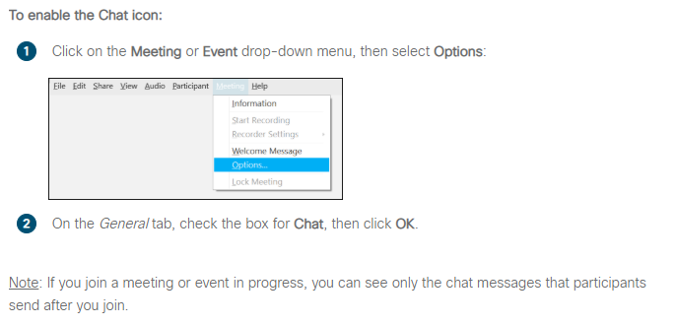
How do I send a chat Message?
Hosts

Slide 10
How to share content

Slide 11
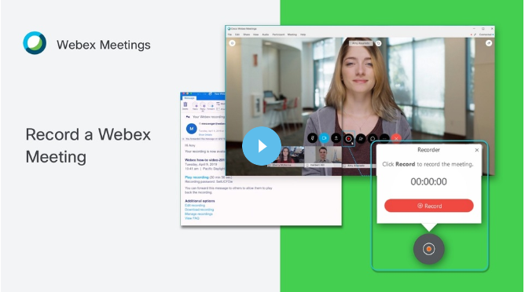
How to record a meeting

Slide 12
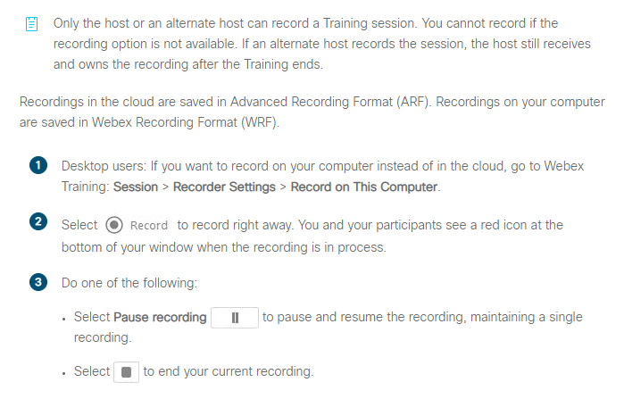
How to record a meeting

