Slide 1
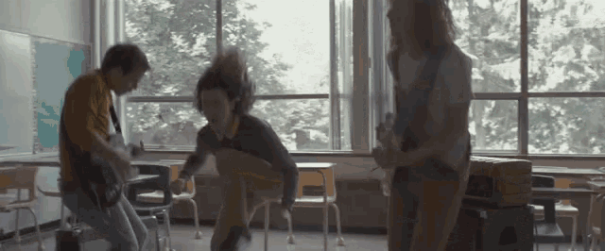
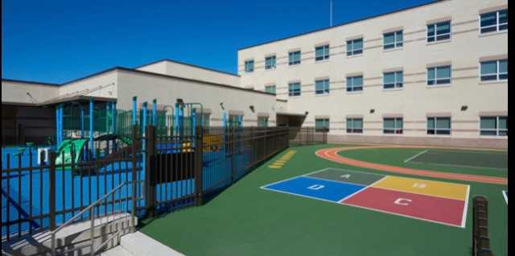
WebEx Expectations
Choose a quiet space, free from distractions. | Be prepared and on time. | Dress appropriately. Wear school colors or your uniform. | Use your full name when you sign into the classroom.
Make sure to enable both audio and video. | Turn on your camera and mute during the lesson. | Participate | Chat responsibly.
 | Attendance will be taken in homeroom and every lesson. |  | .

